Slide 1
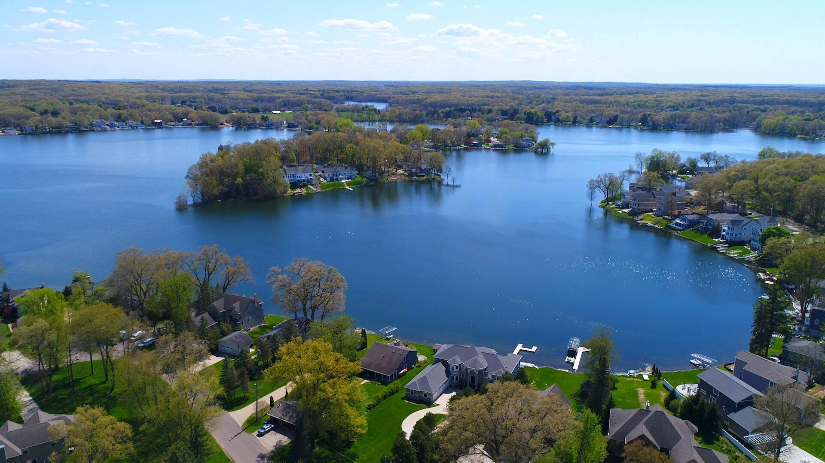
Eagle Lake Annual Meeting
May 19th, 2021 Virtual Zoom Meeting

Slide 2
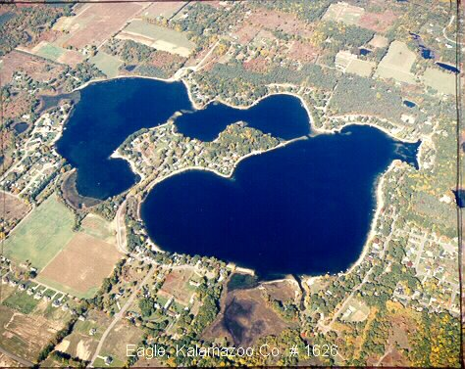
Agenda
Opening Welcome – Amy Coon
Board Nominations and Voting – Ken Toy
Approval of 2020 Annual Meeting Minutes – Brett Cummings
Eagle Lake Annual Report – Dr. Jennifer Jones
Treasurer Report – Jim Caporale
President’s Report – Amy Coon
Long Term Project Update – Amy Coon
Lake Quality – Len Bosma / Phil DeYoung
Communications / Social Committee – Kasi Barrow
Membership Committee – Debra Duncan
Safety and Legal – Debra Duncan
Questions / Comments
Closing – Amy Coon

Slide 3
Nominations and Voting
https://greaterkzooskate.org/2021eltavote/
Voting open until May 20, 11:59pm
Current Nominations
Kasi Barrow
Jason Machnik
Ken Toy
Write-Ins welcome

Slide 4
Approval of 2020 Annual Meeting Minutes
Notes:
Brett

Slide 5
Eagle Lake Annual Report
Dr. Jennifer L. Jermalowicz-Jones Water Resources Director Certified Professional Watershed Manager Restorative Lake Sciences

Slide 6
Treasurer’s Report – Jim Caporale
Presenting the Following Summary Reports
Fiscal Year 2020
ELTA
SAD #1
SAD #2
ELTA Fiscal Year 2021 thru March 31
ELTA
SAD #1
SAD #2
Member Questions/Comments

Slide 7
ELTA – Fiscal Year 2020
Revenues for the Period $ 9,482.73
Expenditures for the Period $ 9,241.74
Net for the Period $ 240.99
Balance Brought Forward Start of the Period $ 13,987.50
Net Funds Available End of the Period $ 14,228.49

Slide 8
SAD #1 – Fiscal Year 2020
Revenues for the Period $ 69.56
Expenditures for the Period $ 26,435.15
Net for the Period $ (26,365.59)
Balance Brought Forward Start of the Period $ 126,549.01
Net Funds Available End of the Period $ 100,183.42

Slide 9
SAD #2 – Fiscal Year 2020
Revenues for the Period $ 70,859.47
Expenditures for the Period $ 38,008.45
Net for the Period $ 41,248.35
Balance Brought Forward Start of the Period $ 51,641.88
Net Funds Available End of the Period $ 92,890.23

Slide 10
ELTA – Fiscal Year 2021 thru Mar 31
Revenues for the Period $ 6,897.18
Expenditures for the Period $ 2,380.93
Net for the Period $ 4,516.25
Balance Brought Forward Start of the Period $ 14,228.49
Net Funds Available End of the Period $ 18,744.74

Slide 11
SAD #1 – Fiscal Year 2021 thru March 31
Revenues for the Period $ 1.60
Expenditures for the Period $ 1,500.00
Net for the Period $ (1,498.40)
Balance Brought Forward Start of the Period $ 100,183.42
Net Funds Available End of the Period $ 98,685.02

Slide 12
SAD #2 – Fiscal Year 2021 thru March 31
Revenues for the Period $ 70,860.97
Expenditures for the Period $ .00
Net for the Period $ 70,860.97
Balance Brought Forward Start of the Period $ 92,890.23
Net Funds Available End of the Period $ 163,751.20

Slide 13
President’s Report – Amy Coon
Spring 2021 vs. Spring 2020
2’9”, 33” down from 5/18/20 to 5/18/21
Sandbag walls going down
Yards and beaches coming back
Wake on the lake!!! Tubers and Waterskiers - yay!
Weeds Topping Out

Slide 14
Short Term Project Update – Amy Coon
Project scheduled to end 9/30/20
EGLE permit extension submitted and granted
Property easements granted after months of negotiations
Pumping rates were reduced per EGLE
8/14/20 (1000/625 gpm) due to wetland stress
9/24/20 we were able to negotiate an increase after a rainfall of over 1/2”
10/14/20 rate increase request, EGLE denied
11/20/20 rate raised to 1200/720 gpm
12/11/20 rate raised to 1400/805 gpm
1/16/21 rate raised to 1600/920 gpm
2/26/21 rate raised to 2000/1100 gpm (we went to 1050 due to Crooked Lake easement negotiation of equal draw down)
4/23/21 Crooked at permit target level, Eagle pump rate increase to 1150 gpm
Project ending this Friday, May 21

Slide 15
Short Term Project Update – Amy Coon
Pumped 933.5 million gallons from Eagle Lake.
Water dropped 3.5’ (42”) from our highest point in 6/20/19.
We are 7” from permit level, but still have another 12-18” after that.
Crooked is down 3.6’ and is 1” away from the permit level.

Slide 16
Long Term Project Update – Amy Coon
Petition for legal lake level submitted to county 1/6/20.
Engineering/Lake Level Study report finished July 2020 and submitted to township, drain commissioner, EGLE, DNR, Crooked Lake, and Eagle Lake for review. Attorney set up conference call to ensure everyone is supportive. This will make court date easier.
Lots of questions from EGLE regarding downstream effects, filter information, and more technical questions
Questions answered and revisions submitted to EGLE on
7/24, 8/21, 9/24, 10/23, 11/19, 12/4, 12/18, 1/8
Final lake level report submitted on 1/22/21.
Attorney submitted petition to court on 2/10/21.
Court date on May 28, 2021 at 9:30 a.m.
Zoom court date, to attend register with the Kalamazoo County Circuit Court. Letter was sent and hearing notice is on the township website and the county website.
Projected Timeline
Continue to be proactive - design work, Road Commission resolution, permit work

Slide 18
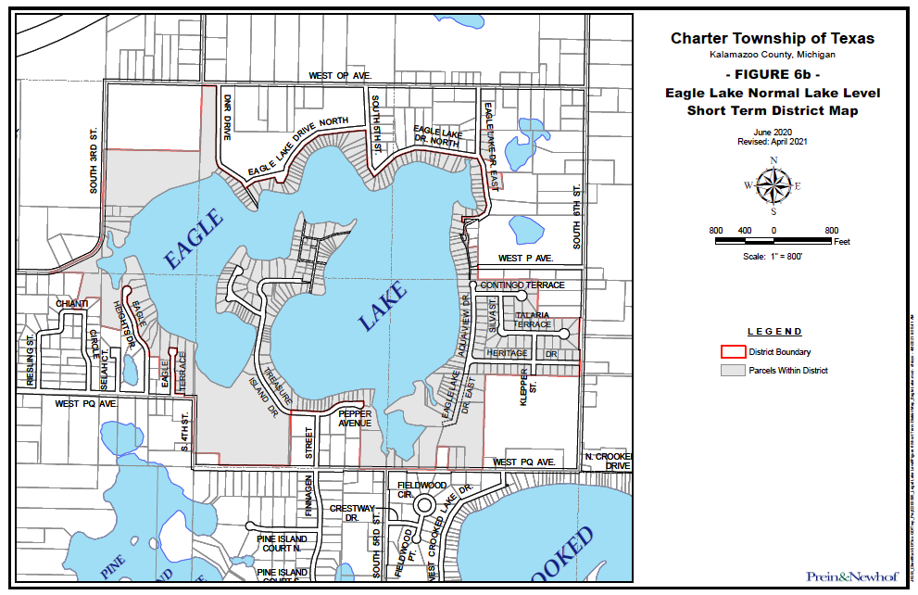

Slide 19
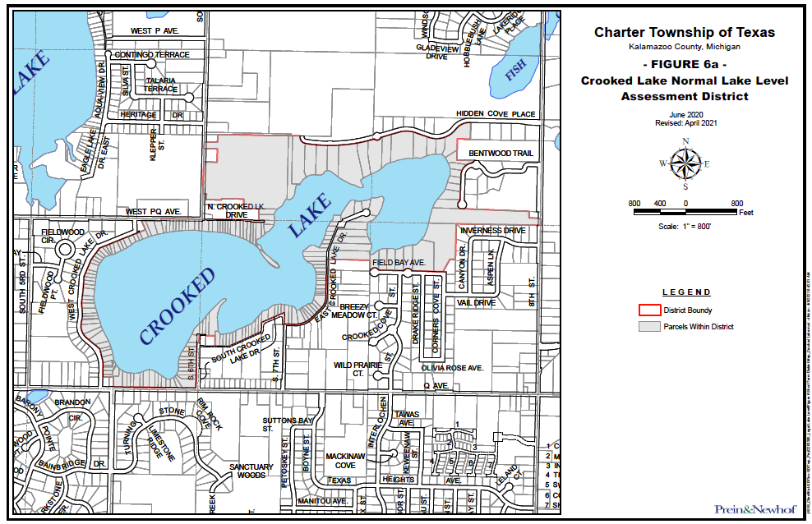

Slide 20
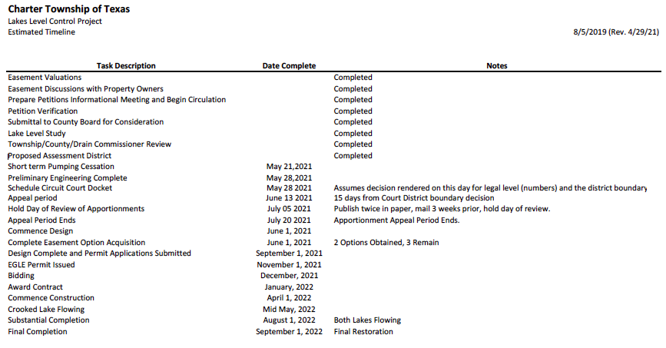

Slide 21
Lake Quality Report
Spring Weed Survey
Aeration Restart
Bio-augmentation Treatment
Goose Roundup

Slide 22
2021 Summer Lake Calendar
May
20 - 7pm Paddle Meet Up @ Basin 2
June
9 - 9am Paddle Meet Up @ Basin 2
11 - 5:01pm Happy Hour @ Sandbar
12 - 1pm Cardboard Regatta hosted by Holly Osmun
17 - 7pm Paddle Meet Up @ Basin 2
25 - Golf @ Ridgeview Golf Course
July
4 - 2pm Annual 4th of July Boat Parade
7 - 9am Paddle Meet Up @ Basin 2
9 - 5:01pm Happy Hour @ Sandbar
15 - 7pm Paddle Meet Up @ Basin 2
17 - 2pm LIVE on the Lake with Kyle Jennings @ Basin 2
August
1 - 10am Kid’s Triathlon hosted by Anna Carlin
11 - 9am Paddle Meet Up @ Basin 2
13 - 5:01pm Happy Hour @ Sandbar
19 - 7pm Paddle Meet Up @ Basin 2
September
8 - 9am Paddle Meet Up @ Basin 2
10 - 5:01pm Happy Hour @ Sandbar
13 - Golf4Youth Scramble @ Milham Park Golf Club
16 - 7pm Paddle Meet Up @ Basin 2

Slide 24
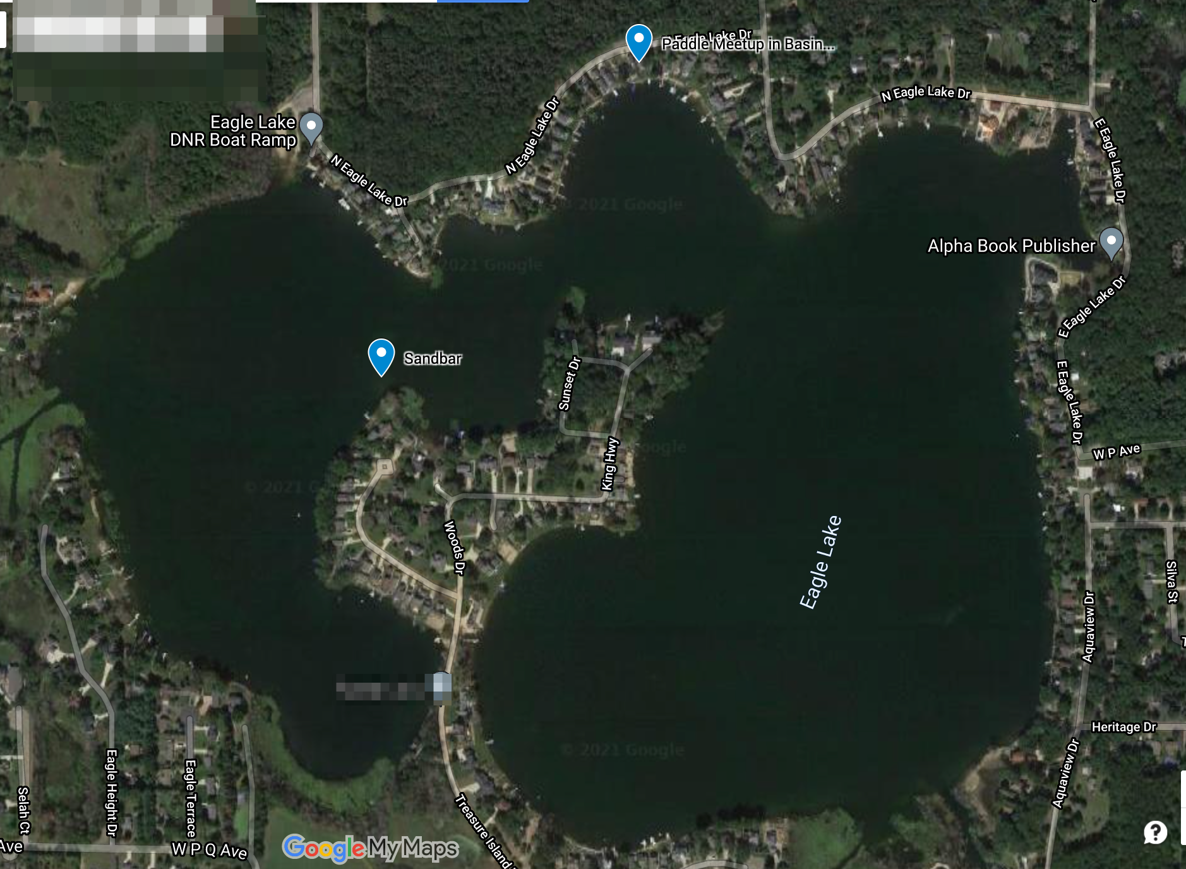

Slide 25
ELTA MEMBERSHIP
2021

Slide 26
EAGLE LAKE MEMBERSHIP COMMITTEE
PROPERTIES
335
MEMBERSHIP
237
PERCENT
71%

Slide 27
AREA 1 – EAST EAGLE LAKE DR
REPRESENTATIVE
MICHELLE LOEDEMAN
PROPERTIES
44
2021 MEMBERS
35
PERCENT
80%

Slide 28
AREA 2 – NORTH EAGLE LAKE DR
REPRESENTATIVE
DEBRA DUNCAN
PROPERTIES
67
2021 MEMBERS
51
PERCENT
76%

Slide 29
AREA 3 – TREASURE ISLAND & PEPPER AVE
REPRESENTATIVE
TOM SPETTEL
PROPERTIES
96
2021 MEMBERS
74
PERCENT
77%

Slide 30
AREA 4 – SOUTH & WEST LAKE
REPRESENTATIVE
KASI BARROW
PROPERTIES
37
2021 MEMBERS
28
PERCENT
76%

Slide 31
AREA 5 – HERITAGE ESTATES 1 & AQUAVIEW
REPRESENTATIVE
NEIL HARRIS
PROPERTIES
55
2021 MEMBERS
32
PERCENT
58%

Slide 32
AREA 6 – HERITAGE ESTATES 2
REPRESENTATIVE
FRANK LOEDEMAN
PROPERTIES
36
2021 MEMBERS
17
PERCENT
47%

Slide 33
Safety and Legal Update

Slide 34
Michigan Marine Law & Boater Safety
All vessels are required to provide at least one United States Coast Guard approved PERSONAL FLOTATION DEVICE per passenger. Each child under the age of 6 years, and in an open deck area is REQUIRED by law to wear a TYPE I or TYPE II PFD AT ALL TIMES!
Slow – no wake speed within 100 feet of the shoreline, any watercraft, pier, person, raft, swimming area, and swimmers.
SLOW – NO WAKE ! Means operating at a very slow to speed in order to minimize the wake created by your vessel.
Maximum speed 55 m.p.h. in all water unless otherwise regulated.
Persons operating vessels shall operate in a counter-clockwise fashion.
The owner of any vessel is personally responsible for any damage to life or property resulting from a wake or swell created by the negligent operation of the vessel, where the vessel is being operated with his consent.
Persons born on or after July 1, 1996 shall not operate a motorboat unless they have been issued a boating safety certificate.
Sailboats have the right-of-way to motorboats while they are under sail power.
Motorboats shall give way to non-motorized vessels.

Slide 35
PERSONAL WATERCRAFT REGULATIONS
A person shall not operate a PWC from sunset to 8:00 A.M local time.
A person shall not cross within 150 ft. behind another vessel or towable other than a personal watercraft, that is moving at greater than a slow – no wake speed.
A person of less than fourteen (14) years of age may not legally operate a PWC under any circumstances.
A person who was born after December 31, 1978 shall not operate a PWC on Michigan waters unless they have obtained a boating safety certificate.
A person 14 or 15 years of age may operate a PWC if:
Have been issued a boating safety certificate and have it aboard the vessel,
Are accompanied by or are operating the PWC no more than 100 feet from a parent, legal guardian, or another designated person of 21 or older.

Slide 36
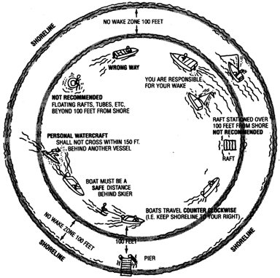
TOWING OF PERSONS
No water skiing/towing between one hour after sunset and one hour prior to sunrise. For a PWC (personal watercraft), no towing between sunset and 8:00am.
At least one competent person, in addition to the driver, shall be in any boat towing persons on water skis, tubes, etc. This additional person shall be in a position to observe the progress of the person being towed.
Vessels and persons being towed on water skis, water sleds, etc. shall maintain a distance of 100 foot from any dock, raft, buoyed or occupied bathing areas, or vessels moored or at anchor, except when the vessel is proceeding at a slow-no wake speed or when water skiers are being picked-up/dropped.

Slide 37
Thank You!

