Slide 1
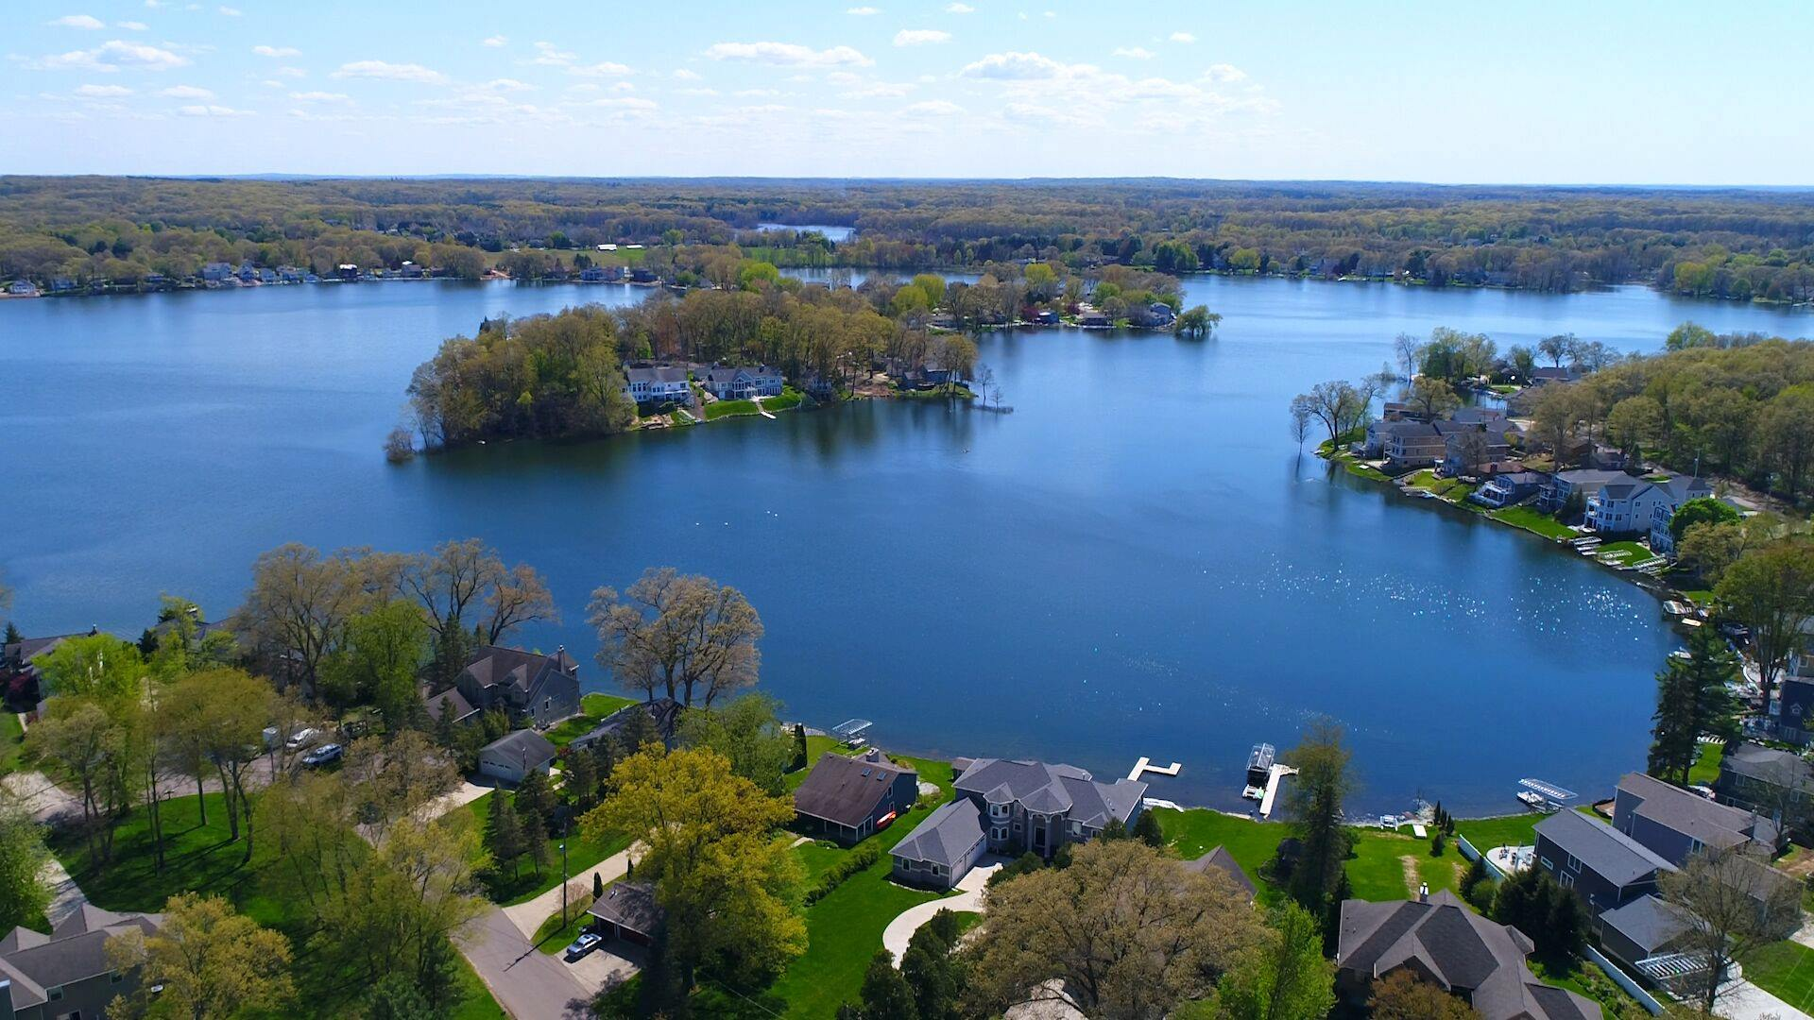
Eagle Lake Annual Meeting
May 18th, 2022 Virtual Zoom Meeting

Slide 2
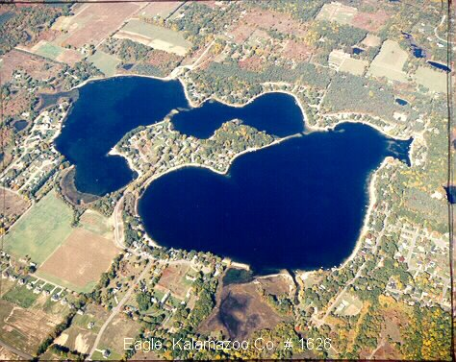
Agenda
Opening Welcome and President’s Report – Amy Coon
Board Nominations and Voting – Ken Toy
Approval of 2021 Annual Meeting Minutes – Steve Ott
Long Term Project Update – Ken Toy / Jason Wiersma
Eagle Lake Annual Report – Dr. Jennifer Jones
Treasurer Report – Jim Caporale
Lake Quality – Phil DeYoung
Communications / Social Committee – Kasi Barrow
Safety and Legal – Jason Machnik
Questions / Comments
Closing – Ken Toy
Notes:
Need to invite Eric Sauro to introduce himself, and invite Frank as well to say anything

Slide 3
Welcome / President’s Report – Amy Coon
Water Level 5/13/22: 900.40
3.12” higher than 5/13/21
7.68” higher than our 4 year all time low (6/15/21 & 9/20/21)
16.8” higher than the LLL (899.26)
36.72” lower than our all time high (June 28,2019)
Many good updates in this meeting
long term drain
Aeration start up
summer social calendar.

Slide 4
Nominations and Voting
https://greaterkzooskate.org/2022eltavote/
Voting open until May 19, 11:59pm
Current Nominations
Amy Coon
Frank Loedeman
Erik Sauro
Write-Ins welcome

Slide 5
Approval of 2021 Annual Meeting Minutes
Notes:
Brett

Slide 6
Long Term Project Update
Legal Lake Level has been approved
Drain Commissioner’s office is now in charge of this project
Initial Project design was a gravity drain with soil barrier filter
EGLE did not approve this design
New design will include electric pumps and old filter
Cost will be spread equally across SAD (incl. Eagle and Crooked)
Easements are nearly complete
Drain Commissioner’s office will operate pumps

Slide 7
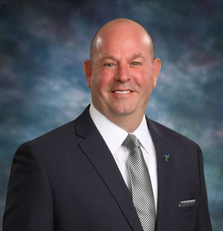
Long Term Project Update
Jason Wiersma
Kalamazoo County Drain Commissioner

Slide 8
Eagle Lake Annual Report
Dr. Jennifer L. Jermalowicz-Jones Water Resources Director Certified Professional Watershed Manager Restorative Lake Sciences

Slide 9
Treasurer’s Report – Jim Caporale
Presenting the Following Summary Reports
Fiscal Year 2021
ELTA
SAD #1
SAD #2
ELTA Fiscal Year 2022 thru March 31
ELTA
SAD #1
SAD #2
Member Questions/Comments

Slide 10
ELTA – Fiscal Year 2021
Revenues for the Period $ 9,482.68
Pass-Thru Revenues from TT for Aerator Power $ 5,169.41
Expenditures for the Period $ 10,814.03
Pass-Thru Expense to Compressor Hosts for Aerator Power $ 5,169.41
Net for the Period $ (1,331.35)
Balance Brought Forward Start of the Period $ 14,228.49
Net Funds Available End of the Period $ 12,897.14

Slide 11
SAD #1 – Fiscal Year 2021
Revenues for the Period $ 6.99
Expenditures for the Period $ 24,975.80
Net for the Period $ (24,968.81)
Balance Brought Forward Start of the Period $ 100,183.42
Net Funds Available End of the Period $ 75,214.61

Slide 12
SAD #2 – Fiscal Year 2021
Revenues for the Period $ 71,693.17
Expenditures for the Period $ 68,915.39
Net for the Period $ 2,777.78
Balance Brought Forward Start of the Period $ 92,890.23
Net Funds Available End of the Period $ 95,668.01

Slide 13
ELTA – Fiscal Year 2022 thru Mar 31
Revenues for the Period $ 7,397.05
Expenditures for the Period $ 1,647.49
Net for the Period $ 5,749.56
Balance Brought Forward Start of the Period $ 12,897.14
Net Funds Available End of the Period $ 18,646.70

Slide 14
SAD #1 – Fiscal Year 2022 thru March 31
Revenues for the Period $ 1.72
Expenditures for the Period $ 4,403.97
Net for the Period $ (4,402.25)
Balance Brought Forward Start of the Period $ 75,214.61
Net Funds Available End of the Period $ 70,812.36

Slide 15
SAD #2 – Fiscal Year 2022 thru March 31
Revenues for the Period $ 2.23
Expenditures for the Period $ 586.00
Net for the Period $ (583.77)
Balance Brought Forward Start of the Period $ 95,668.01
Net Funds Available End of the Period $ 95,084.24

Slide 16
Lake Quality Report
Spring Weed Survey
Aeration Restart
Bio-augmentation Treatment
Goose Roundup

Slide 17
2022 Summer Lake Calendar
June
3 - Happy Hour with Live Music @ Sandbar
17 – Golf4Youth scramble @ Milham Park Golf Club
July
1 - Happy Hour with Live Music @ Sandbar
4 - Annual 4th of July Boat Parade
16 – Cardboard Regatta
21 – Charity benefit concert with Ryan Stevenson
August
5 - Happy Hour with Live Music @ Sandbar
21 – Live on the Lake with Kyle Jennings
27 – Kids Triathlon
27 – Poker Run
September
2 - Happy Hour with Live Music @ Sandbar

Slide 18
Safety and Legal Update
Stay Safe
Use Common Sense
Always Watch for Boaters and Swimmers

Slide 19
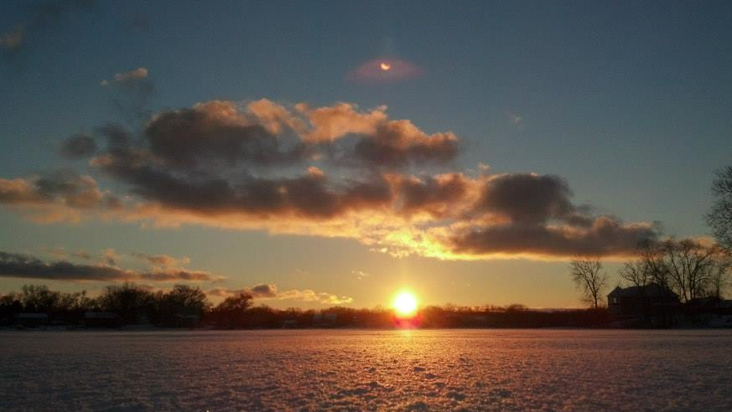
Thank You!

