Slide 1
FLOODING CRISIS
Presentation to Kalamazoo County Board of Commissioners
April 16, 2019

Slide 2
Texas Township Flooding
Introduction
What’s Happening in Texas Township
Indeed … it’s a local flooding Catastrophe
A Slow Motion Disaster that started in Oct of 2017
The water levels keep rising …
Who’s Affected
800-1000 Texas Township residents impacted
Eagle Lake, Crooked Lake, Pine Lake, Vineyards, & others
The winter melt and spring rains typically raise the lakes 12”; which will exacerbate this catastrophic situation

Slide 3
Flood Damage Submissions (as of 10/24/2018)

Slide 4
Current Status
600 + residents have reported damage
Damage reports include:
12 abandoned homes – under water and moldy
Hundreds of flooded basements and walkouts
Thousands of dead mature trees
Countless ruined yards
Residents have spent thousands of dollars on protection
The average drainage system cost is $20K-$40K
The typical average seawall cost is $30-$40K
Tree removals are typically $2-$20K
Texas Township has committed significant funds, including:
$125,000 in general fund monies towards the flooding
Temporary emergency road stabilization projects expected to cost $108,000
Costs associated with establishing the Special Assessment District
The remainder of the costs will be borne by the SAD
However, pictures tell a better story

Slide 5
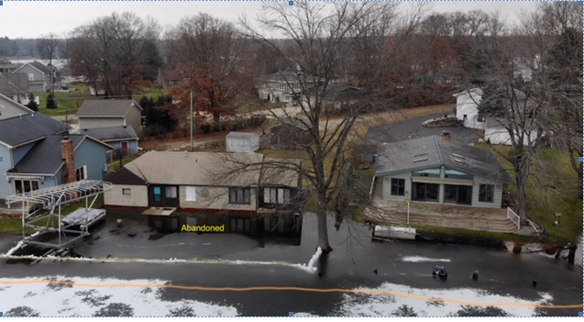
Eagle Lake

Slide 6
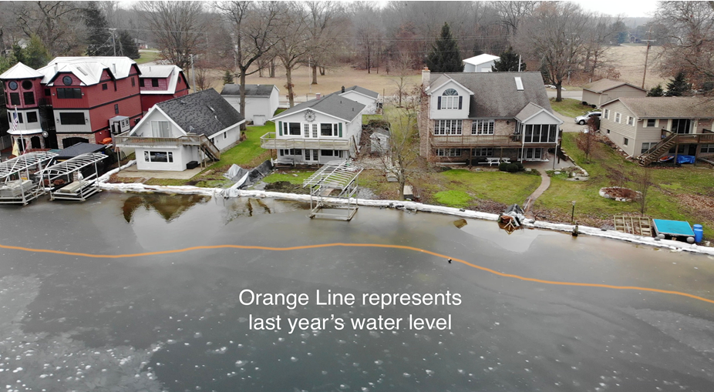
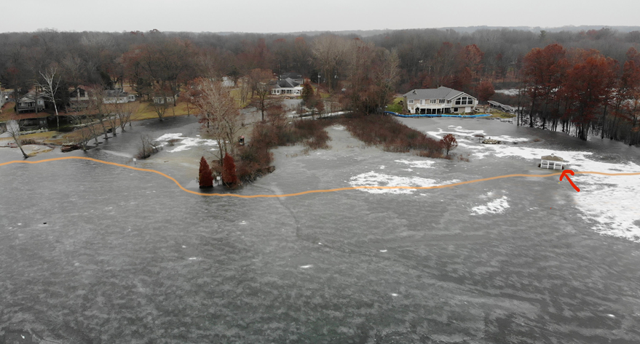
Eagle Lake

Slide 7
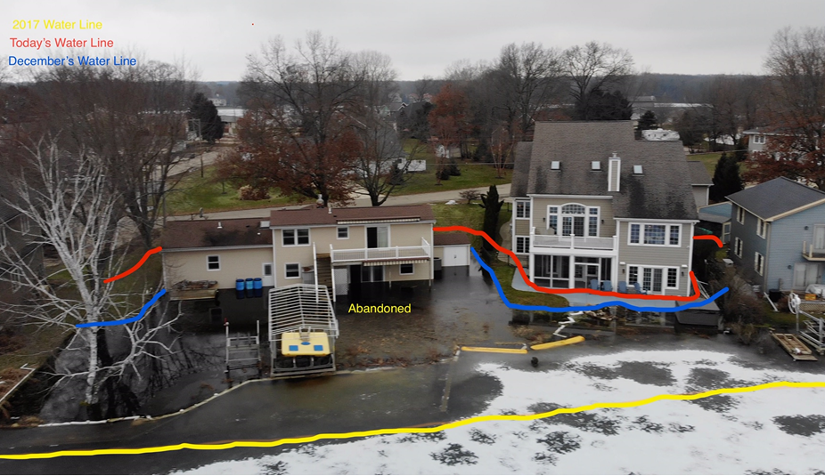
Eagle Lake

Slide 8
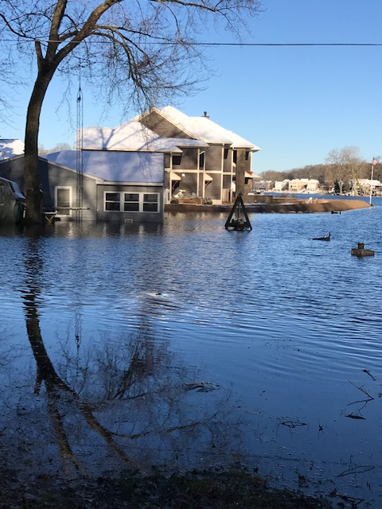
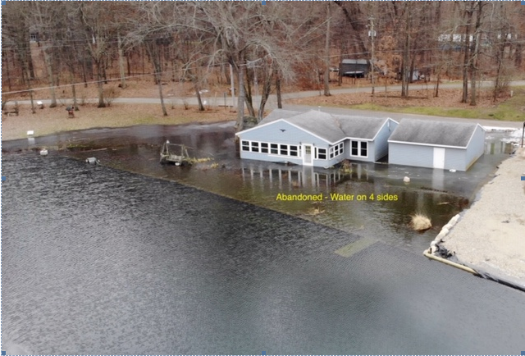
Eagle Lake

Slide 9
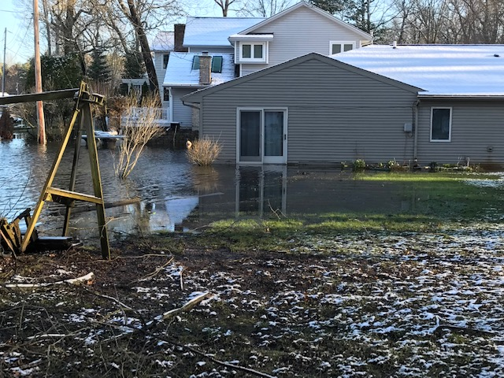
Crooked Lake

Slide 10
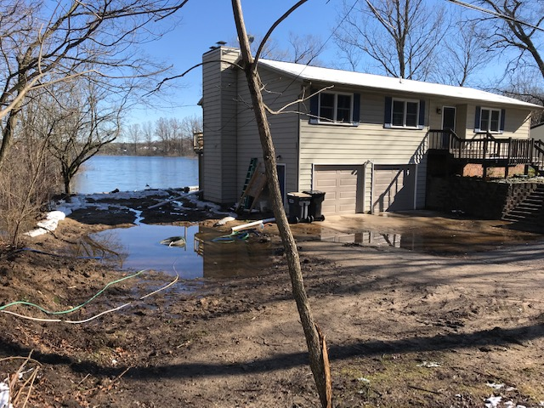
Eagle Lake

Slide 11
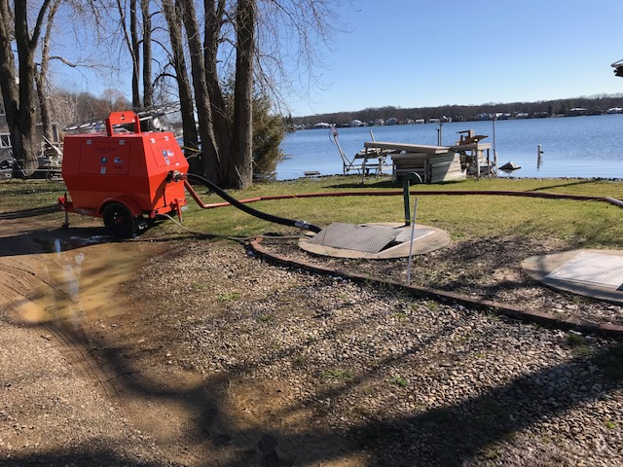
Eagle Lake – Treasure Island

Slide 12
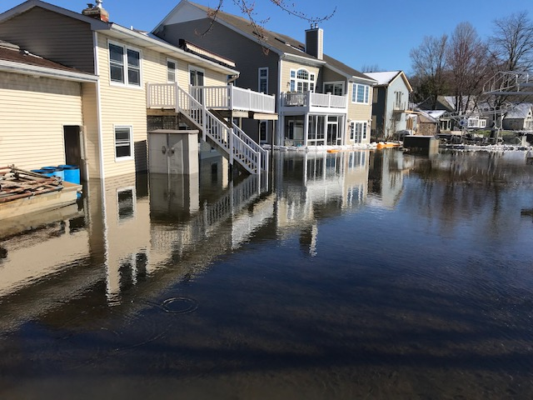
Eagle Lake – Treasure Island

Slide 13
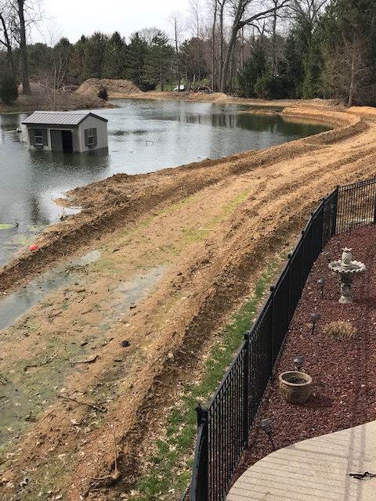
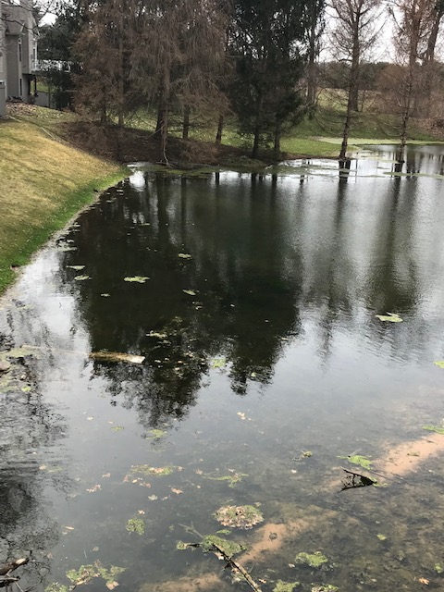
Pine Island Development

Slide 14
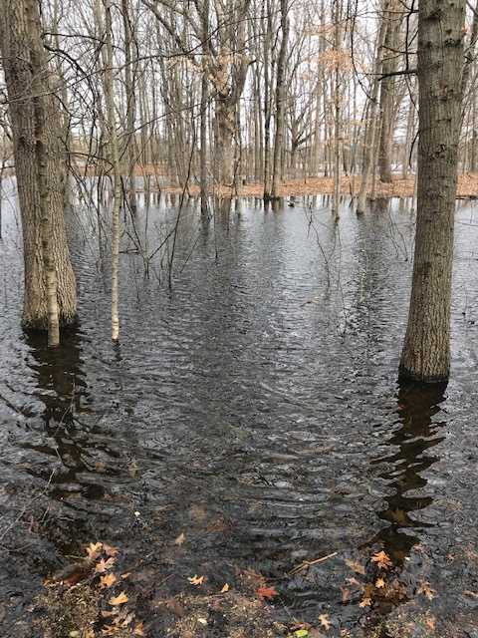
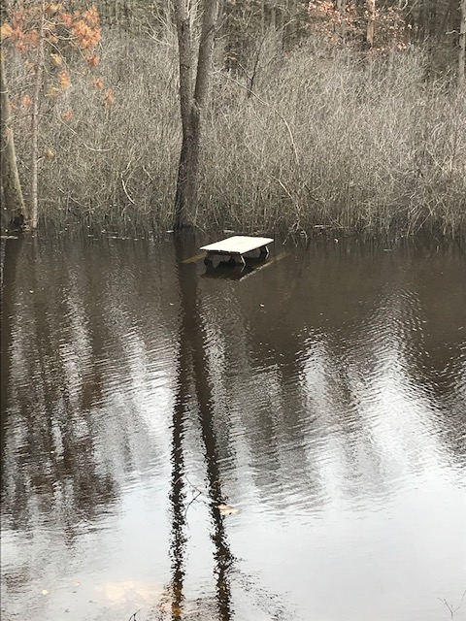
Pine Island Lake

Slide 15
Short Term Solution
It has been a long journey … WITH … significant obstacles
Texas Township Flooding Task Force was established in Aug 2017
Texas Township Trustees and staff; Prein & Newhof Engineers, lake and neighborhood associations
RCKC, Drain Commissioner, COK Public Services Director, Portage Public Services Director, MDOT, Kal Emergency Manager,
MDEQ; State Representatives, County Representatives
The MDEQ approved the Short Term Pumping Permit on March 29, 2019. The approved pumping plan had lots of detailed input
Multiple public hearings – with hundreds in attendance
Prein&Newhof solution designed by engineers
Pumping (2000 GPM) from Eagle to Crooked to Bass lake outlet
DEQ permit addressed downstream concerns
Piping and specialty filters ordered and easements obtained
Proposed SAD to pay for the estimated $1.5 million
Hopefully, we will be able to pump at the end of May
Residents are praying ….

Slide 17
Long Term Solution
A permanent solution is required … so this doesn’t happen again
It would follow the same fundamentals of the short term solution
Similar route … using same precautions; except for
Using gravity flow … not electric pumps
Employing buried pipes … not above ground piping
Constructing permanent structures … versus temporary structures
This will be a project of the Kalamazoo Drain Commissioner
The Drain Commissioner has indicated that
Since the lakes function as retention depositories for whole area
The proposed drainage district will be a much bigger geographic area
And, it will cost significantly more than the short term solution

Slide 18
We Need Your Help
We anticipate the long term solution will be complicated because
Additional jurisdictions will be involved
The scope is significant because of infrastructure required
The cost will be greater
This is truly a crisis
This is a community problem
The future of Texas Township is at stake. Texas Township pre-emptively reduced $7,000,000 worth of taxable values for 2018 Taxes. An approximate additional $2,000,000 was reduced during BOR.
This flooding solution is bigger than the Township’s authority
We need the support of the Kalamazoo County Commissioners
We wanted to tell you first hand so you know what’s happening
Help us determine the best solution – we can’t do this by ourselves
Your assistance is desperately needed – and it will be appreciated

