Slide 1
Eagle Lake LFA Update
Dr. Jennifer L. Jermalowicz-jones
Restorative lake sciences

Slide 2
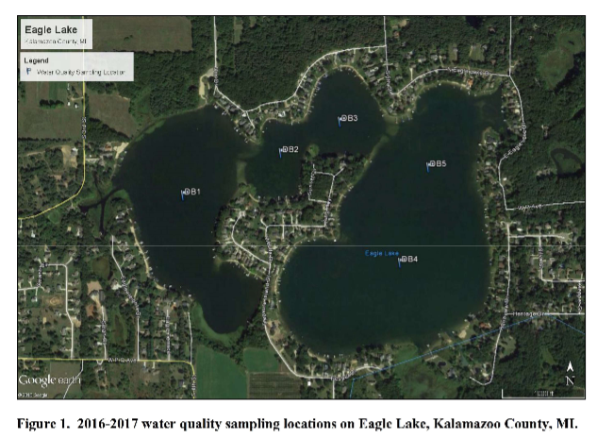
Water Quality Sampling Locations

Slide 3
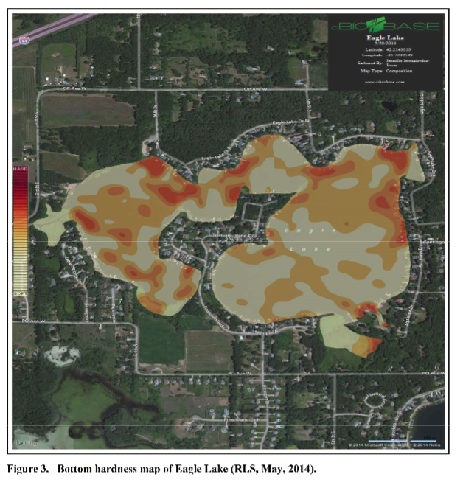
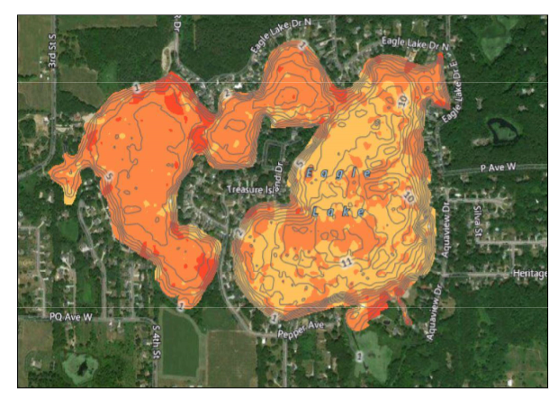
Baseline to 2017 Muck Comparisons (Note: Much less soft bottom!)
2014 Muck
2017 Muck
Beige color = soft bottom
Orange color = firmer bottom

Slide 4
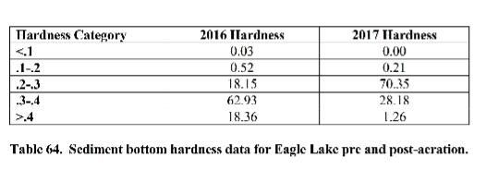
Changes in Sediment Bottom Hardness

Slide 5
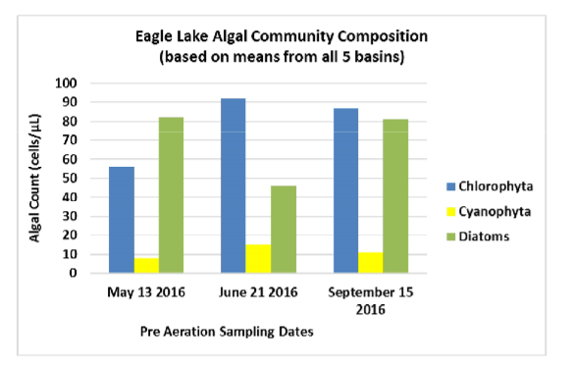
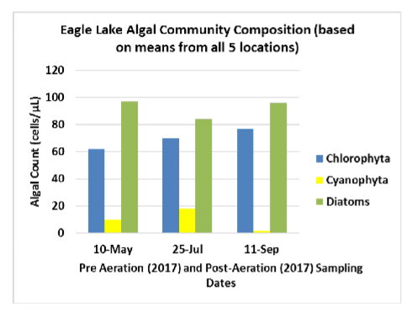
Algal Comparisons (More diatoms = healthier lake!)
2016 Algae
2017 Algae

Slide 6
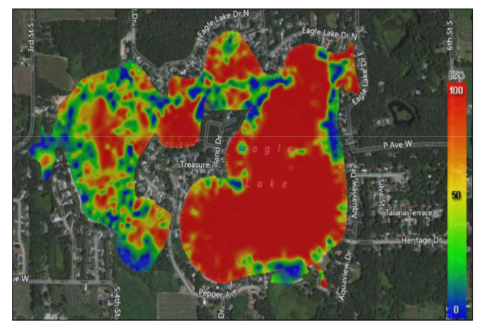
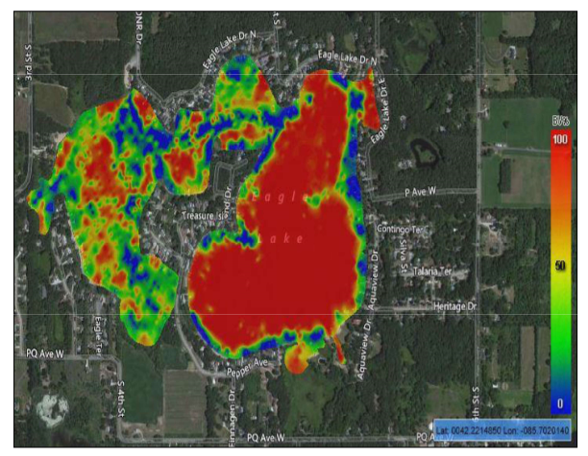
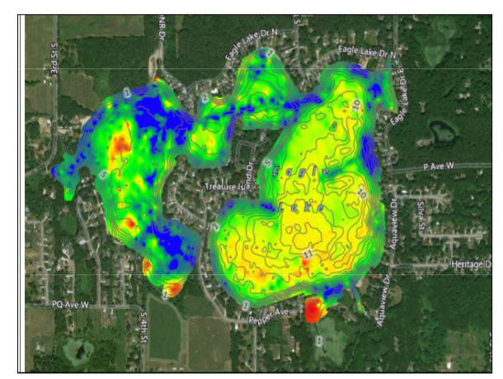
Aquatic Vegetation Biovolume Comparisons
May, 2016 Biovolume
May, 2017 Biovolume
October, 2017 Biovolume

Slide 7
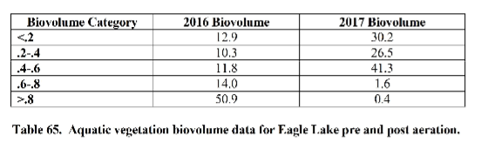
Changes in Aquatic Plant Biovolume (Less dense categories increasing, more dense-decreasing!)

Slide 8
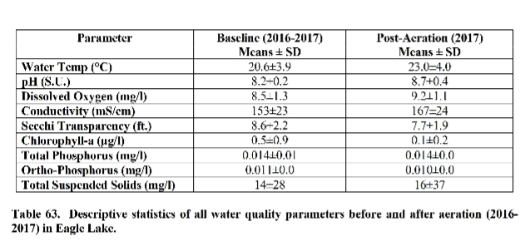
Overall WQ Results to Date: (DO is increasing!)

