Slide 1
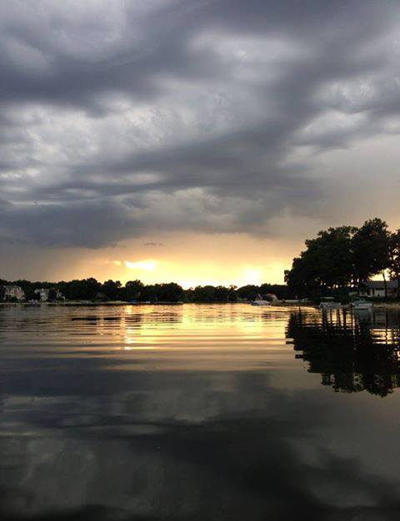
Eagle Lake Annual Meeting
August 19th, 2020 Virtual Zoom Meeting

Slide 2
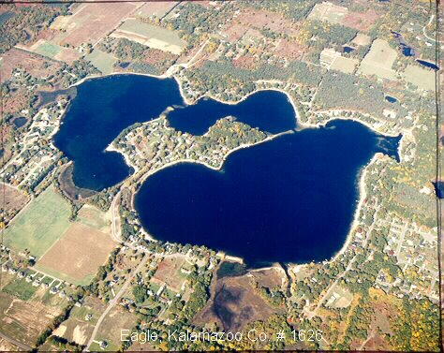
Agenda
Opening Welcome – Amy Coon
Board Nominations and Voting – Ken Toy
Approval of 2019 Annual Meeting Minutes – Brett Cummings
Eagle Lake Annual Report – Jennifer Jones
Treasurer Report – Jim Caporale
President’s Report – Amy Coon
Long Term Project Update – Len Bosma
Lake Quality – Len Bosma / Phil DeYoung
Communications – Ken Toy
Membership Committee – Tom Spettel
Safety and Legal – Brett Cummings
Closing – Amy Coon

Slide 3
Nominations and Voting
https://greaterkzooskate.org/2020eltavote/
Voting open until August 20, 11:59pm
Current Nominations
  Jim Caporale
  Len Bosma
  Phil DeYoung
Write-Ins welcome

Slide 4
Approval of 2019 Annual Meeting Minutes

Slide 5
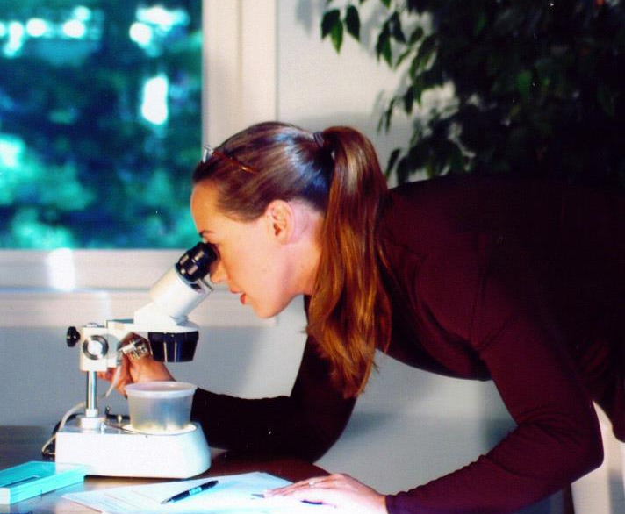
Eagle Lake Annual Report
Dr. Jennifer L. Jermalowicz-Jones
Water Resources Director
Certified Professional Watershed Manager
Restorative Lake Sciences

Slide 6
Annual Meeting of the Members
Financial Report – August 19,2020
Presenting The Following Summary Reports
ELTA – Fiscal Year 2019
ELTA – Fiscal Year 2020 thru June 30
SAD #1 – Fiscal Year 2019
SAD #1 – Fiscal Year 2020 thru June 30
SAD #2 – Fiscal Year 2019
SAD #2 – Fiscal Year 2020 thru June 30
Member Questions/Comments
Notes:
For all line item detail for Fiscal Year 2019 – Please refer to the 1st Quarter Newsletter Treasurer Report on Page 3
For all line item detail for Fiscal Year 2020 – Please refer to the 3rd Quarter Newsletter Treasurer Report on Page 3

Slide 7
Eagle Lake Texas Association
Fiscal Year 2019
Revenues for the Period $ 10,164
Expenditures for the Period $ 9,314
Net for the Period $ 850
Balance Brought Forward Start of the Period $ 13,138
Net Funds Available End of the Period $ 13,988
To see line item detail refer to 1st Quarter Newsletter
Notes:
Revenues – Dues/Donations $7,740; Newsletter Ads $2,400; Expenditures – Admin $3,100; Committee Projects $1,154; Newsletter $4,760

Slide 8
Eagle Lake Texas Association
Fiscal Year 2020 thru June 30
Revenues for the Period $ 7,894
Expenditures for the Period $ 5,607
Net for the Period $ 2,207
Balance Brought Forward Start of the Period $ 13,988
Net Funds Available End of the Period $ 16,275
To see line item detail refer to 3rd Quarter Newsletter
Notes:
Revenues – Dues/Donations $7,885; Expenditures – Admin $323; Committee Projects $2,835; Newsletter $2,301

Slide 9
Eagle Lake SAD #1 – Weed Control
Fiscal Year 2019
Revenues for the Period $ 82,781
Expenditures for the Period $ 28,232
Net for the Period $ 54,549
Balance Brought Forward Start of the Period $ 72,000
Net Funds Available End of the Period $126,549
To see line item detail refer to 1st Quarter Newsletter
Notes:
Revenues – Special Assessment; Expenditures – Engineering Services $8,160; Weed Treatment $18,970

Slide 10
Eagle Lake SAD #1 – Weed Control
Fiscal Year 2020 thru June 30
Revenues for the Period $ 62
Expenditures for the Period $ 10,866
Net for the Period $ (10,804)
Balance Brought Forward Start of the Period $126,549
Net Funds Available End of the Period $115,745
To see line item detail refer to 3rd Quarter Newsletter
Notes:
Revenues – Special Assessment on hold due to SAD for Pumping Project; Expenditures – Engineering Services $5,250; Weed Treatment $5,250

Slide 11
Eagle Lake SAD #2 – Aeration Project
Fiscal Year 2019
Revenues for the Period $ 83,628
Expenditures for the Period $ 55,661
Net for the Period $ 27,967
Balance Brought Forward Start of the Period $ 23,675
Net Funds Available End of the Period $ 51,642
To see line item detail refer to 1st Quarter Newsletter
Notes:
Revenues – Special Assessment; Expenditures – Bio-Augmentation $54,720

Slide 12
Eagle Lake SAD #2 – Aeration Project
Fiscal Year 2020 thru June 30
Revenues for the Period $ 76,572
Expenditures for the Period $ 20,783
Net for the Period $ 55,789
Balance Brought Forward Start of the Period $ 51,642
Net Funds Available End of the Period $107,431
To see line item detail refer to 3rd Quarter Newsletter
Notes:
Revenues – Special Assessment; Expenditures – 1st Bio-Augmentation Treatment

Slide 13
President’s Report
Flooding continues on Eagle Lake - 2020 highest year of rainfall on record
Short Term Pumping continues, despite bumps in the road from EGLE (formerly DEQ)
610 million gallons pumped out of Eagle Lake as of 8/18.

Slide 14
President’s Report

Slide 15
President’s Report
EGLE Permit expires 9/30/20. Township has requested an extension and we are still waiting on an answer.
Property Easements expires 11/20/20. Currently, all property owners have agreed to an easement extension, EXCEPT the Bentwood Shores Association. They hold the easement to the wetland.
EGLE decided to scale the pumps back to 1000 gal/min. last week.
SOME GOOD NEWS - Lake is the lowest we have seen in 2 years! Down 22 inches from the highest point.
MORE GOOD NEWS - Long Term Solution is progressing.

Slide 16
Long Term Project Update
Task Description Date Complete Status
Easement Valuations 8/29/2019 Completed
Easement Discussions with
Property Owners Sep-19 Ongoing
Prepare Petitions informational Meeting
and begin Circulation Oct-19 Completed
Petition Verification Dec-19 Completed
Submittal to County Board Jan-Feb 2020 Completed
Lake Level Study Mar-20 Completed
Township/County/Drain
Commissioner Review Apr-20 In Progress

Slide 17
Long Term Project Update
Task Description Date Complete Status
Schedule Circuit Court Docket Aug-20 Pending
Create Assessment District: Complete by Oct-20
Appeals Period End Nov-20
Design Complete Feb-21
MDEQ Permitting Apr-21
Bidding May-21
Begin Construction Jun-21
Complete Construction Nov-21

Slide 18
Lake Quality Report
Aeration
Weed Treatment
Bio-augmentation
Goose Roundup
Purple Loosestrife

Slide 19
Communication Committee
Digital Newsletter
Email List
Facebook https://www.facebook.com/EagleLakeAssociation/
Website https://www.eaglelakekzoo.com/

Slide 20


Slide 21

Where are we now?
242 members
Target for 2020 is 250 members
Please - be one of the “final 8” to help us reach the target. Go to our website and Join tonight!

Slide 22
Why join ELTA?
Joining ELTA is the single most important thing you can do to:
  Protect & Improve the Environment of Eagle Lake.
  Demonstrate that “I Care About My Lake”.
  Demonstrate support for ELTA activities and Officers.

Slide 23
Why join ELTA?
ELTA has a much stronger voice than any individual
in working with:
  Texas Township
  EGLE (Michigan DEQ)
  Kalamazoo County
    Board
    Court
    Drain commission
    Road commission

Slide 24
Please Join Now!
New members will receive an ELTA Membership sticker for your boat, car or mailbox.
Show your support.

Slide 25
Safety and Legal Update

Slide 26
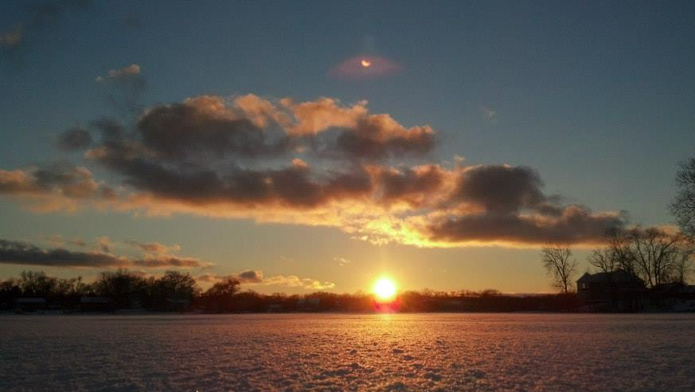
Thank You!

