Slide 1
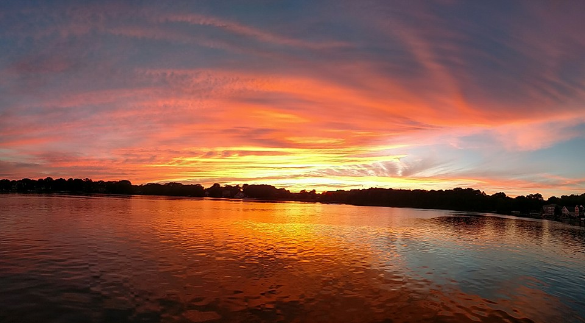
Eagle Lake Annual Meeting
May 15th, 2019 Texas Township Hall

Slide 2
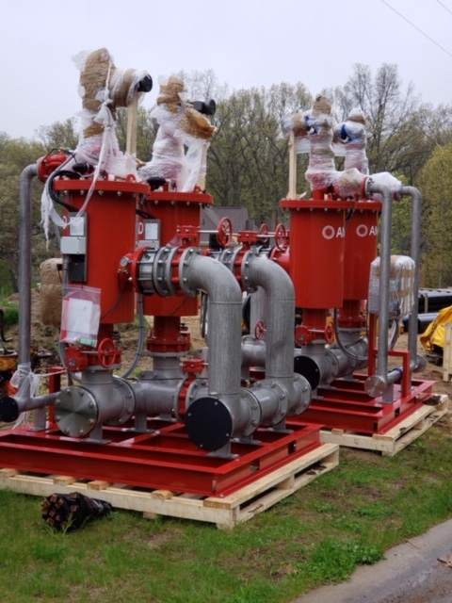
Agenda
Opening Welcome
Minutes From Last Annual Meeting
Nominations for Directors
Election of Directors
President’s Report
Trish Roberts - SADs
Treasurer’s Report
Old Business
  Committee Reports
    Lake Quality
    Safety and Legal
    Membership
    Communications
New Business
  Election Results
Questions and Answers
Adjournment

Slide 3
President’s Report
2018/2019 Lake Level Summary
Explanation of Pumping Restrictions
Pumping Plan
Legal Lake Level and the Long Term Solution
Texas Township Updates

Slide 4
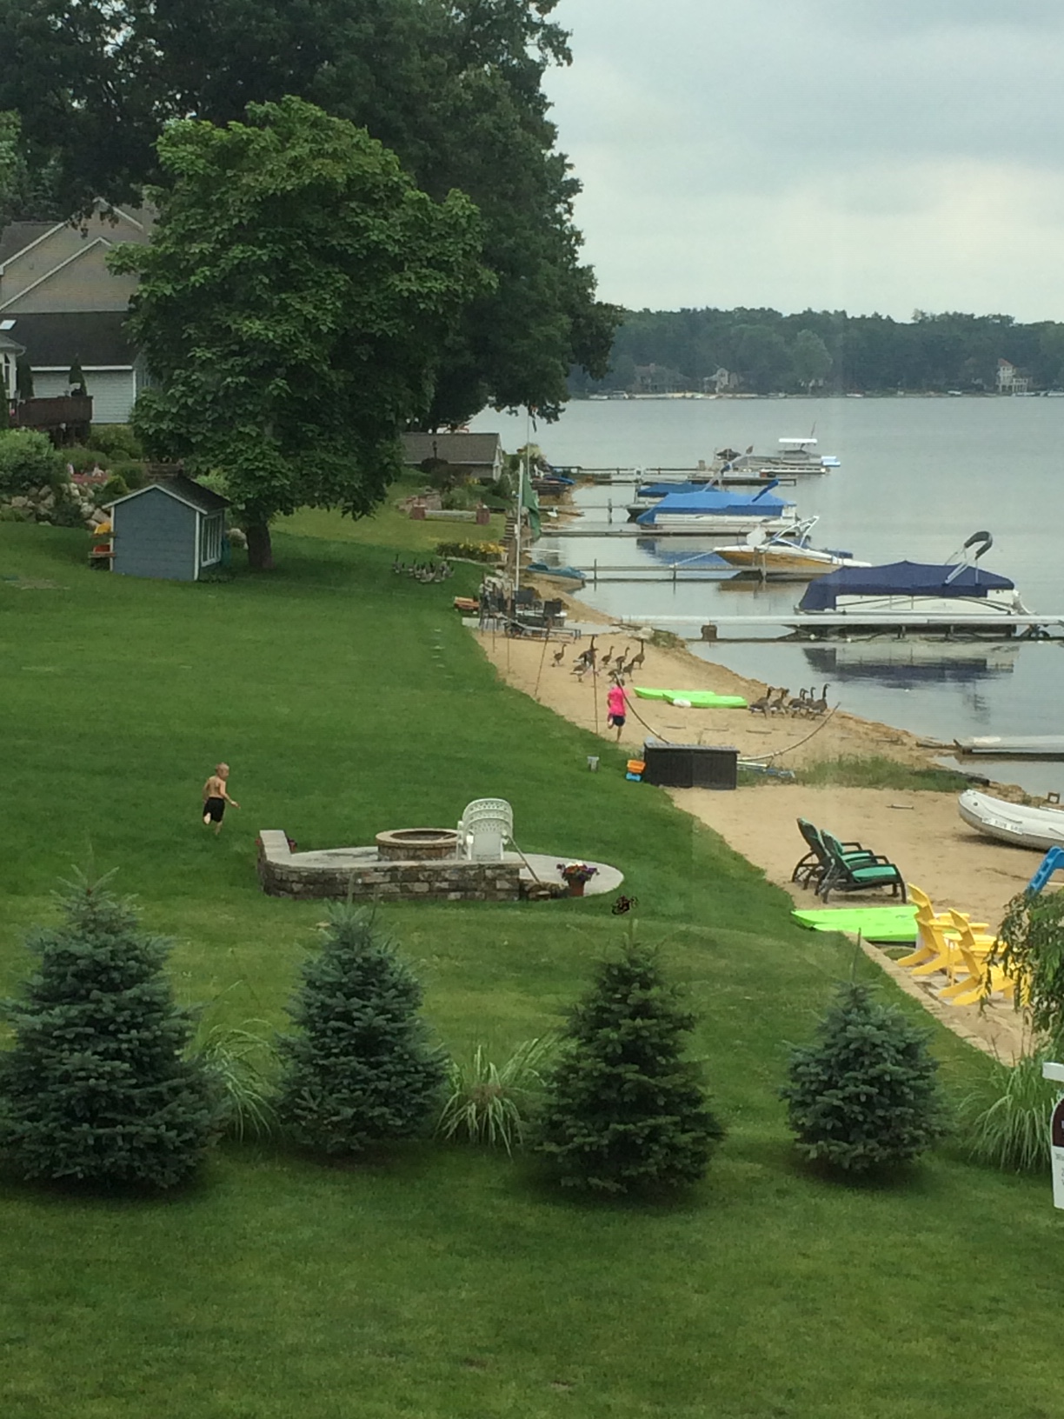
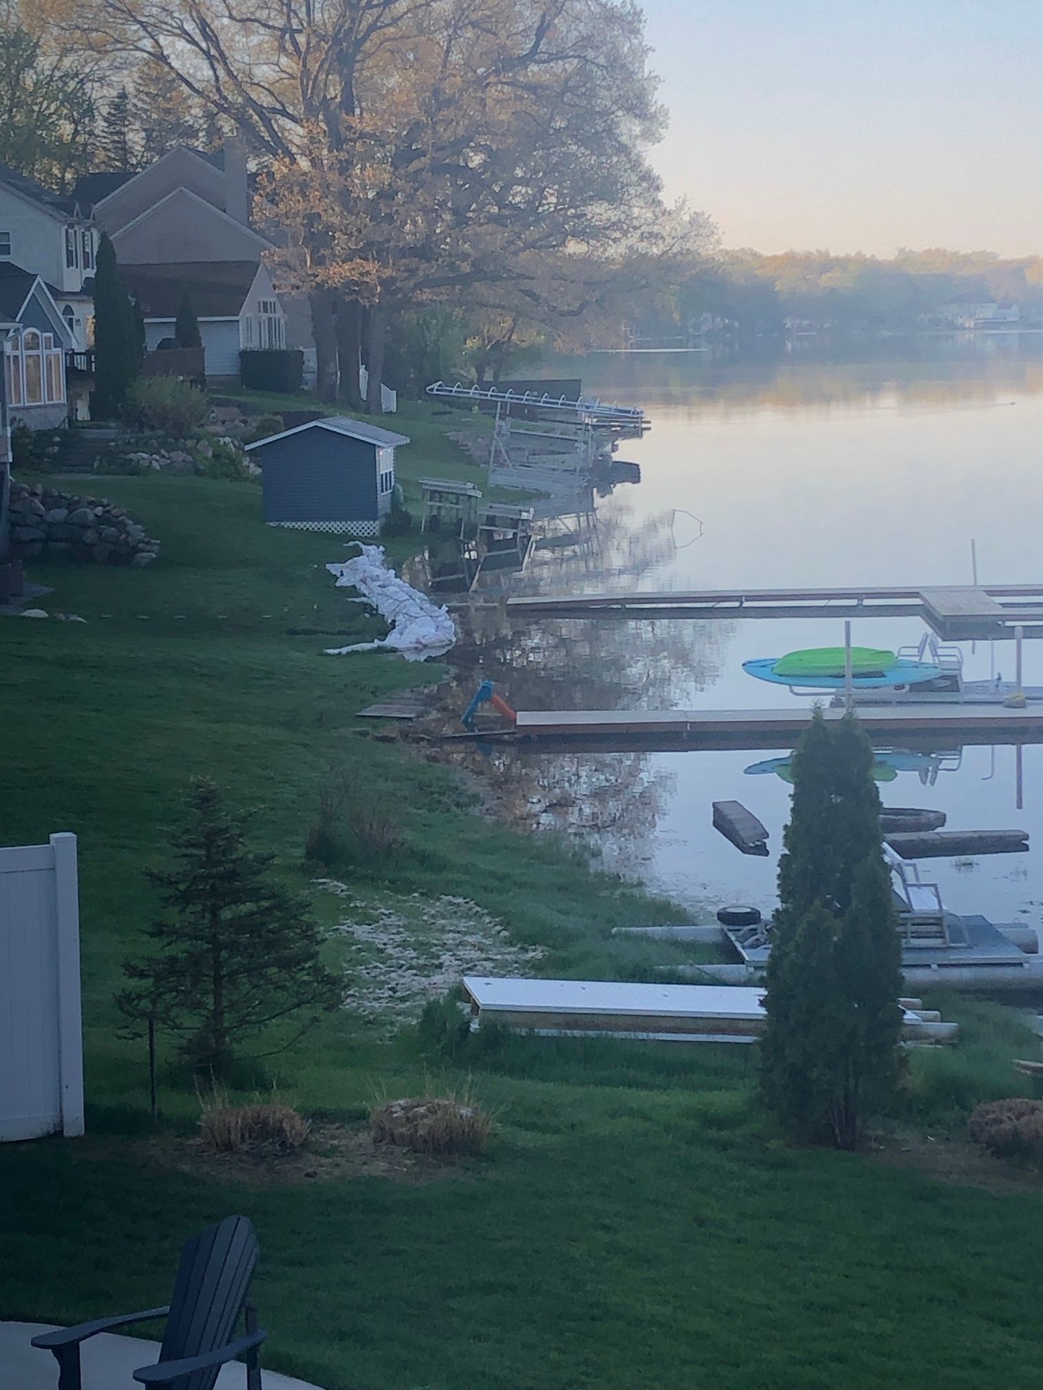
President’s Report

Slide 5
President’s Report – Lake Levels
Water Levels
  8/31/2018: 14.75”
  5/14/2019: 30”
Task Force Creation
Obtaining the DEQ Permit
  This kind of permit has never been issued at this scale
Bass Lake Opposition

Slide 6
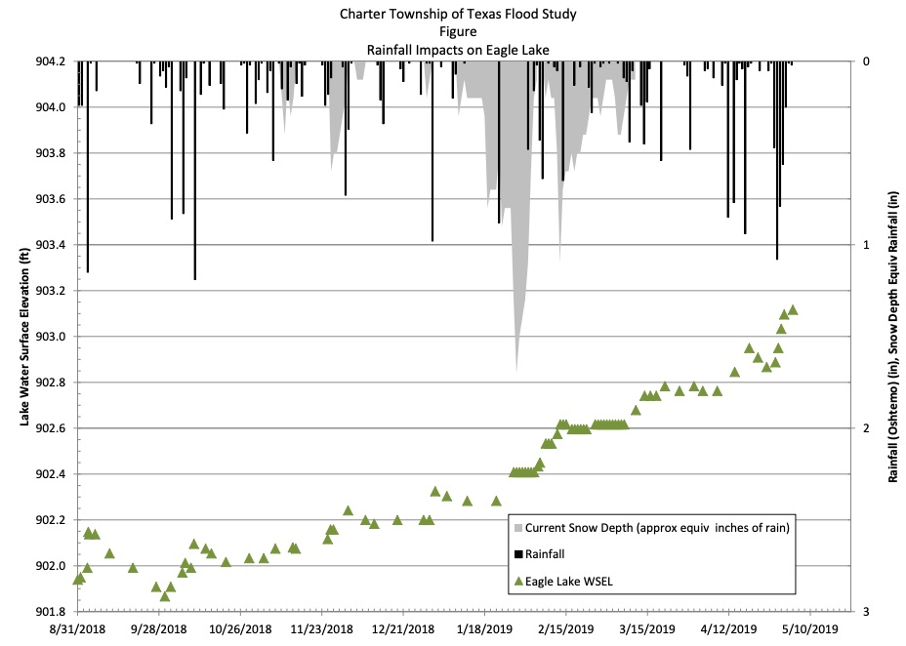

Slide 7
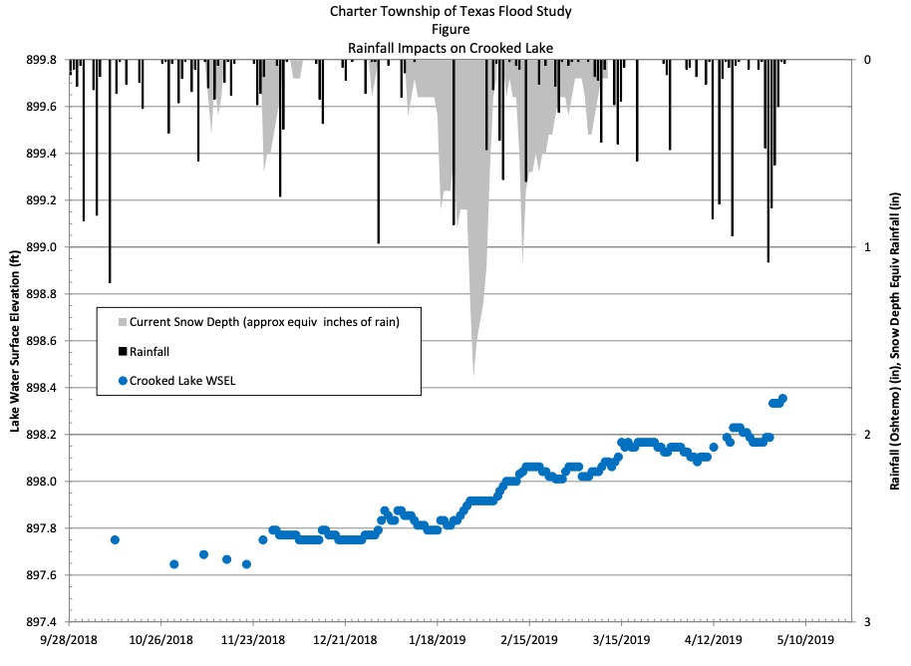

Slide 8
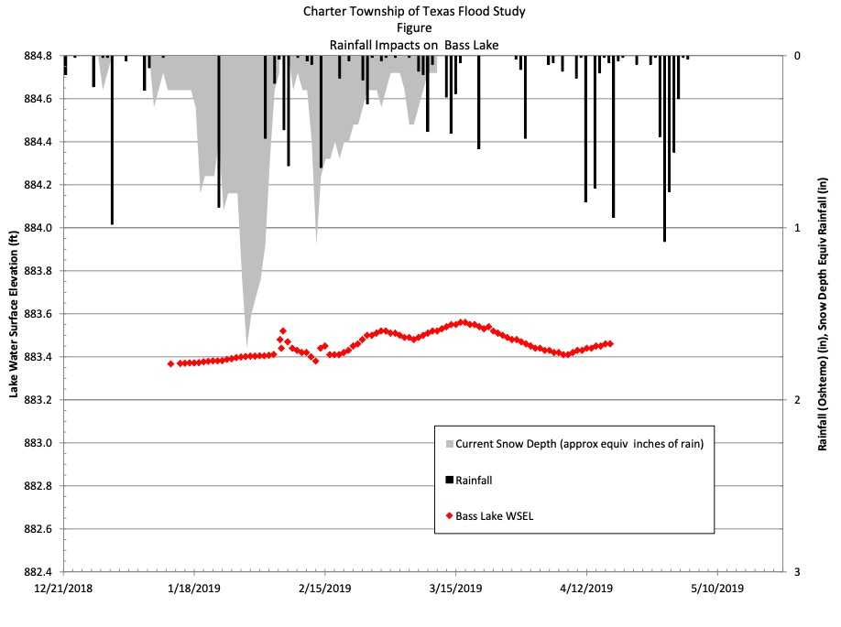

Slide 9
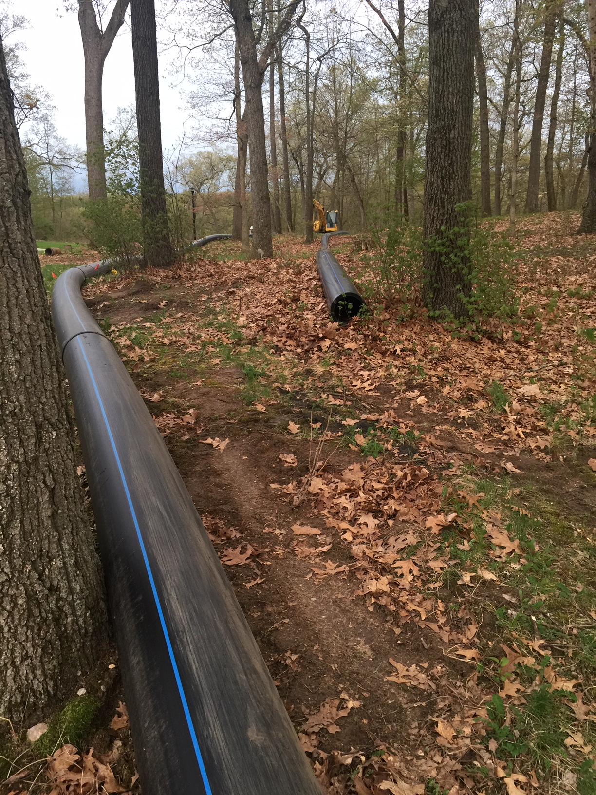
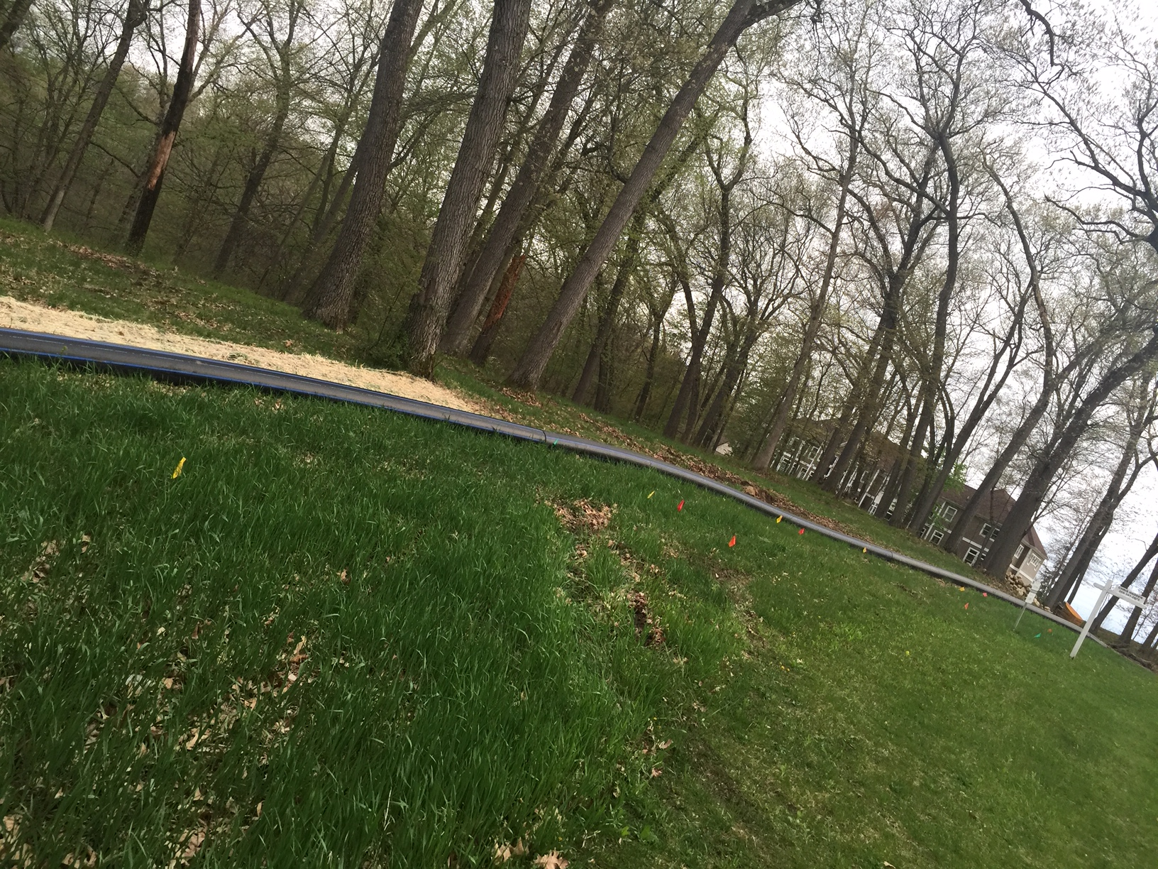
President’s Report
Permit Highlights
(or lowlights)

Slide 10
Permit Details
Copy of 8 page long permit is on the township website. 28 conditions listed. Highlights are:
  Water monitoring 3x/wk at
    8th St. culvert
    Boy Scout culvert
    12th St. culvert
    After a rain of 2” or more
  Daily inspections at
    Eagle & Crooked intake pumps
    Eagle pump discharge site to Crooked
    Crooked pump discharge to wetlands
    Al Sabo culvert
    Sun Valley Drive in the city of Kalamazoo
  Wetlands monitored once/week by a qualified wetland professional.

Slide 11
Pumping Will Cease If…
Water surface elevation reaches
  885.8 at 8th Street
  884.99 at Boy Scout culvert
  869.05 at 12th St.
Sun Valley Drive is inundated with water and impassable
Portage Creek exceeds flows of 200 CFS
Kalamazoo River at Comstock exceeds flows of 3100
13 consecutive days of pumping. Pumping will cease for 2 days to minimize potential adverse conditions to aquatic wildlife
MDEQ can cease pumping or decrease flow at anytime if determined pumping is having an adverse impact on environment

Slide 12
Other Pumping Details
1st week flow will be
  1000 gallons/min from Eagle to Crooked
  1000 gallons/min. From Crooked to Bass
  Can increase to 1000 gal/min and 2000 gal/min if approved by MDEQ
Be prepared for a slow and gradual decrease of water.
  10 million gallons/week pumped out
  Equates to about an inch drawdown per week
Permit valid until 9/30/2020
  Unless target drawdown elevation has not been reached.
  Township can request an extension of 1 year.
Eagle Lake target drawdown elevation is 899.8
Crooked Lake target drawdown elevation is 892.9

Slide 13
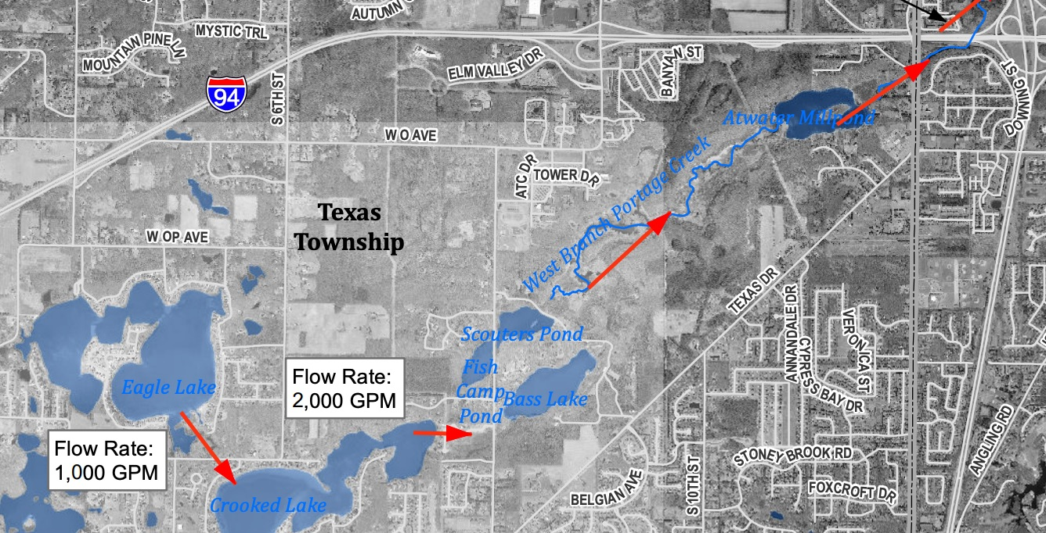
President’s Report
President’s Report – Pumping Plan

Slide 14
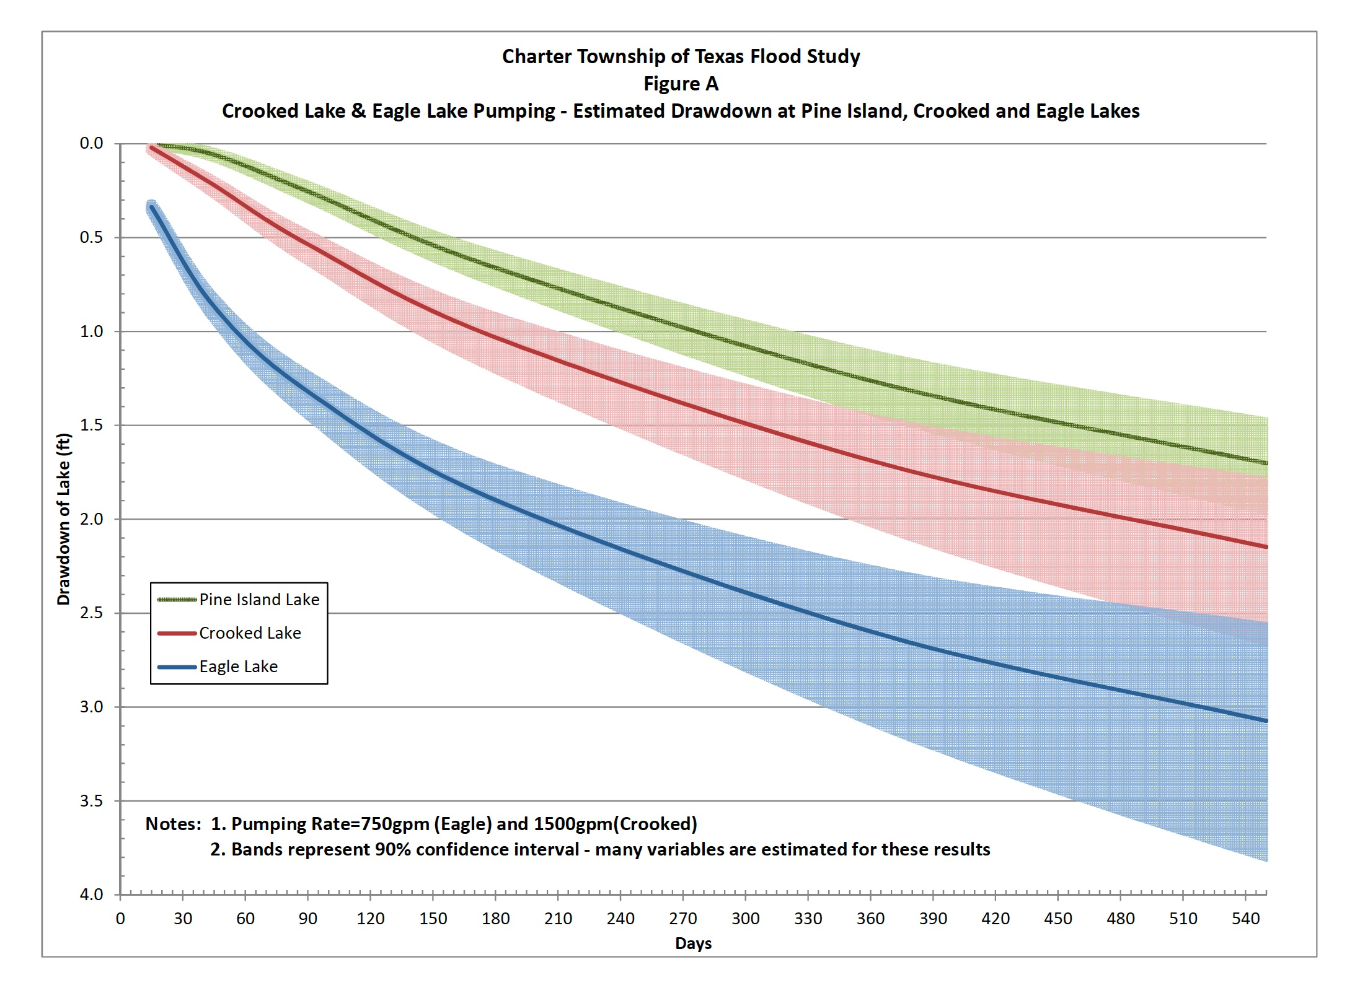
President’s Report – Drawdown Rates

Slide 15
When Can We Pump???
When will the pumps turn on
  Hopefully early next week
Why can’t they turn on now
  It was always estimated start up would be significant work after the filters are delivered: setting the units, processing piping equipment, discharge line placement, electrical connection to filter, system start-up
System start up means the equipment manufacturer on site to properly ensure proper performance.
Once start up is complete, pumping will begin the next business day to ensure time to chase down issues that may pop up when pumping begins.
We need to make sure the set up and installation is 100% correct or the MDEQ can stop the pumping

Slide 16
Legal Lake Level and the Long Term Solution
We need a permanent fix
Forming a new committee and looking for volunteers
Purpose is to research and facilitate legal lake level process, the long term solution, and provide recommendation on how Eagle Lake should proceed
Committee will also serve as a liaison between the county and Eagle Lake

Slide 17
Texas Township Updates
Waterfront Property Zoning - on hold
Updated Master Plan
6th St Park - Board awarding contract at next meeting
6th St Park - Construction will commence this summer

Slide 18
Trish Roberts
Special Assessment Districts

Slide 19
Treasurer’s Report – SAD 1
2018
2019

Slide 20
Treasurer’s Report – SAD 2
2018
2019

Slide 21
Treasurer’s Report – ELTA
2018
2019

Slide 22
Lake Quality Committee
Aeration System Update (sites, equipment, electric)
Lake Survey (May 10th)
Bio-Augmentation Plan
Goose Roundup
Purple Loosestrife

Slide 23

Legal and Safety Committee
New Boating and Fishing Laws to Prevent the Introduction and Spread of Invasive Species
Michigan’s Natural Resources and Environmental Protection Act(Act 451 of 1994) Part 413hasamended with changes for boaters and anglers that take effect March 21, 2019. The changes are intended to strengthen protection for Michigan waterways against the introduction and spread of aquatic invasive species.
What boaters need to know:
Prior to the amendment, the law only required that a person not place watercraft or trailers in the waters of Michigan if an aquatic plant is attached. In addition to this requirement, the new changes require all of the following prior to transporting any watercraft over land:
  Removing all drain plugs from bilges, ballast tanks, and live wells.
  Draining all water from any live wells and bilges.
  Ensuring that the watercraft, trailer, and any conveyance used to transport the watercraft or trailer are free of aquatic organisms, including plants.
  This means that after trailering boats and before getting on the road, boaters must pull plugs, drain water and remove plants and debris.
Violation of the law is a state civil infraction and violators may be subject to fines up to $100.

Slide 24
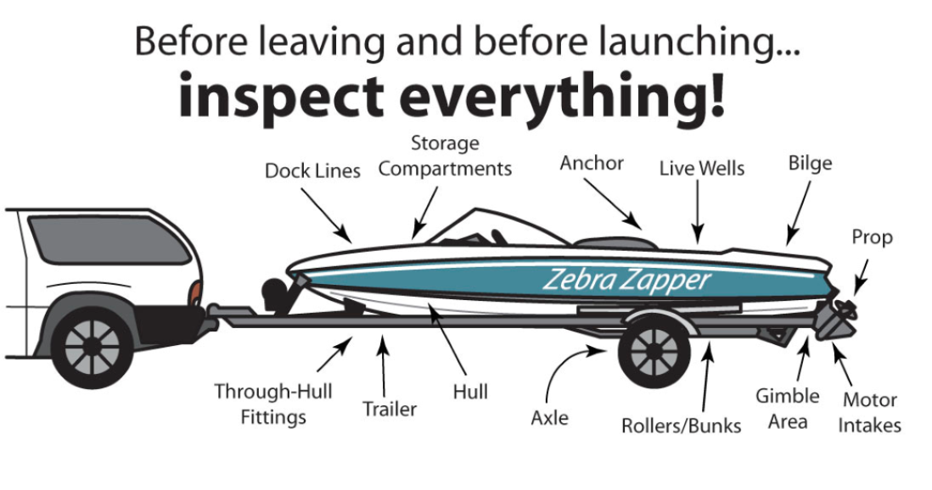
Legal and Safety Committee
What you should do:
To comply with the law and prevent the introduction and spread of aquatic invasive species, boaters should:
  CLEAN boats, trailers and equipment
  DRAIN live wells, bilges and all water - pull all drain plugs
  DRY boats and equipment
  DISPOSE of unwanted bait in the trash

Slide 25
Membership Committee - Update
As of May 12, 2019, we have 223 paid out of 336 possible members (66%). Our goal for 2019 is 250 members.
  Area 1 – East Eagle Lake Drive is at 33 of 40 (75%)
  Area 2 – North Eagle Lake Drive is at 47 of 66 (71%)
  Area 3 – Treasure Island/Pepper is at 75 of 97 (77%)
  Area 4 – South and West Eagle Lake is at 27 of 37 (73%)
  Area 5 – Heritage Estates i is at 26 of 56 (46%)\
  Area 6 – Heritage Estates ii is at 15 of 36 (42%)

Slide 26
Membership Committee - Representatives
Area 1: East Eagle Lake Drive --------------------------- Michelle Loedeman
Area 2: North Eagle Lake Drive ------------------------ Debra Duncan
Area 3: Treasure Island/Pepper ------------------------- Tom Spettel
  Alec Cumming – Block Captain
  Megan Vroegindewey – Block Captain
Area 4: South and West Lake --------------------------- Kasi Barrow
Area 5: Heritage Estates I --------------------------------- Neil Harris
Area 6: Heritage Estates II -------------------------------- Frank Loedeman

Slide 27
Membership Committee – Why Join?
ELTA is an organization that has your interests as a Lake resident at heart.
Our primary focus over the years has been in the following areas:
  Explore opportunities to improve, maintain and protect Eagle Lake.
  Encourage communication, cooperation and understanding between all law-abiding users of the Lake.
  Provide community awareness through safety education and programs.
  Control and prevent water pollution and to otherwise improve the condition of the lake for recreational and aesthetic purposes.
  Raise the level of awareness of the public about environmentally significant activities affecting the lake.

Slide 28
Membership Committee – Recent Focus
Recently, we have widened our efforts to include solving the high water level problem that have devastated many of our neighbors. ELTA has been actively working with:
  State and local governments through attendance (and presentations) at meetings and membership on various committees.
  The Texas Township Board.
  The Road Commission of Kalamazoo County.
  The Kalamazoo County Drain Commission and County Board.
We have meet with our state representatives in Lansing. We also work closely with the Crooked Lake Association.

Slide 29
Membership Committee
Your participation is needed
You can help by:
Becoming a member.
Encouraging neighbors to become members.
Participate by joining a committee. Contact any Director or committee chair.

Slide 30
Communication Committee
Email List
Facebook https://www.facebook.com/EagleLakeAssociation/
Website https://www.eaglelakekzoo.com/
Social Events

Slide 31
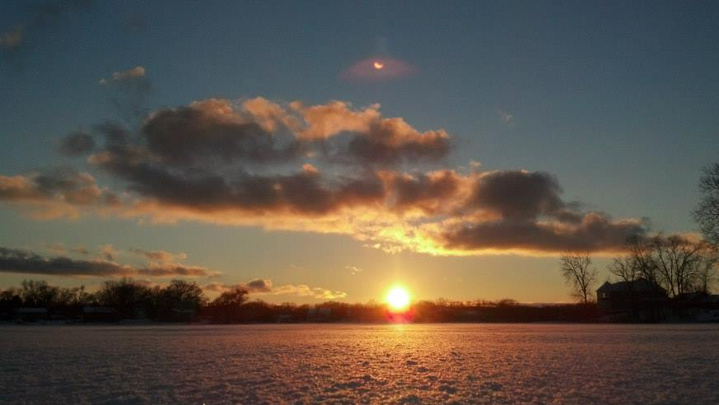
Thank You!

