Slide 1
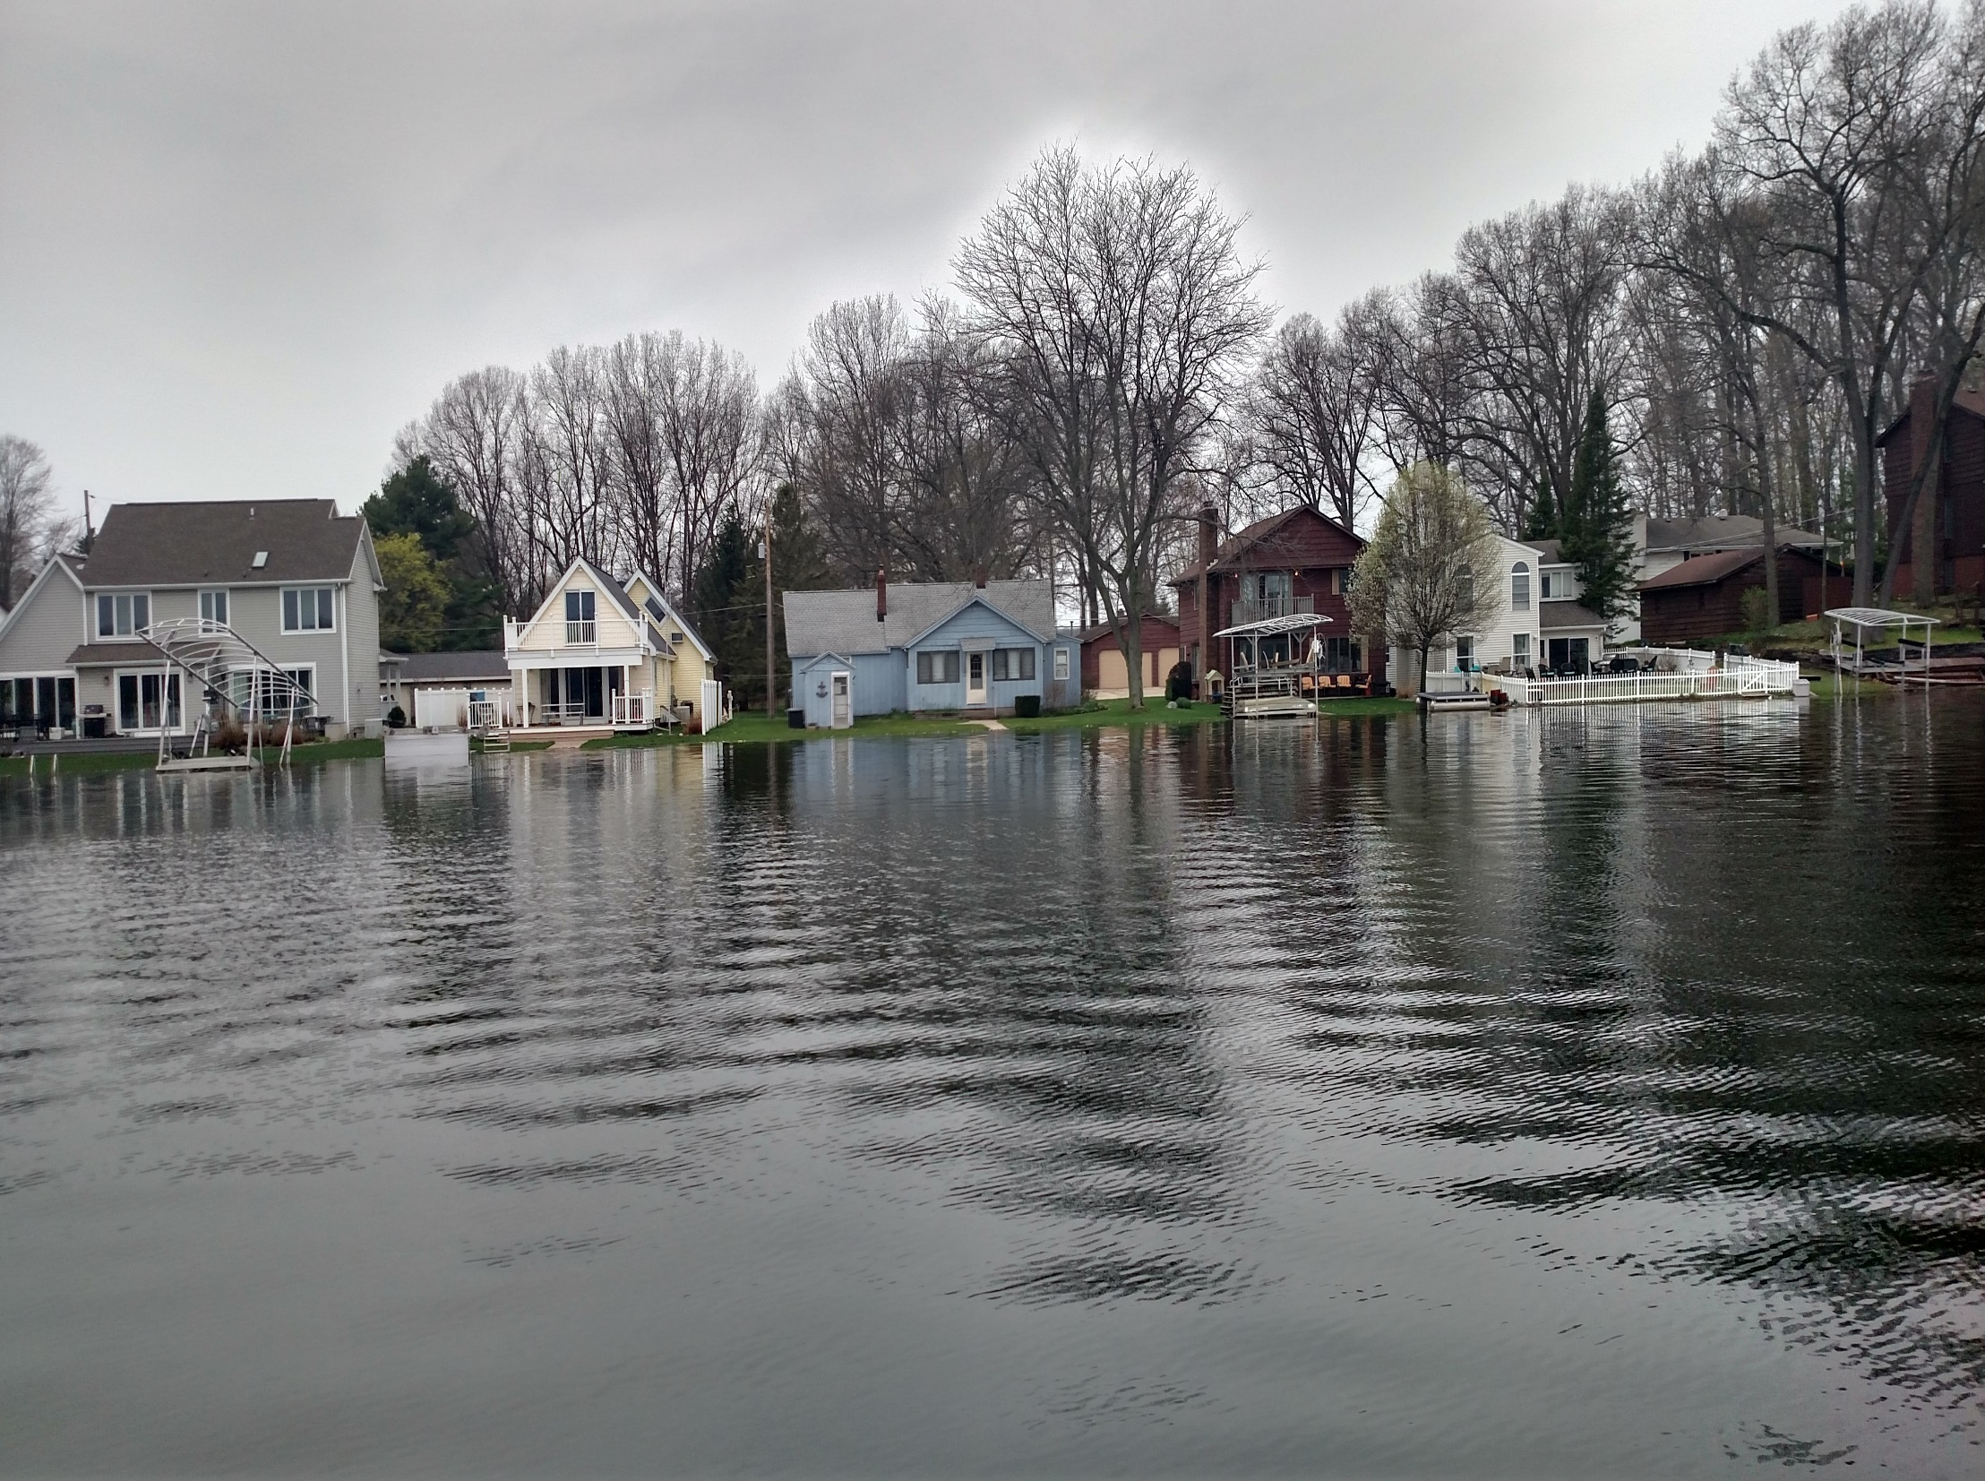
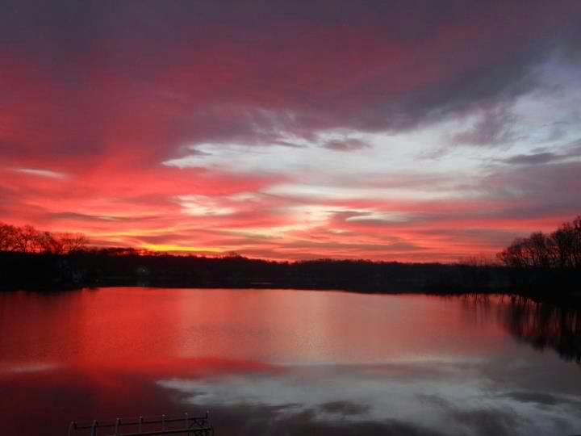
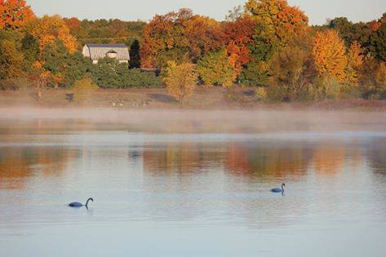
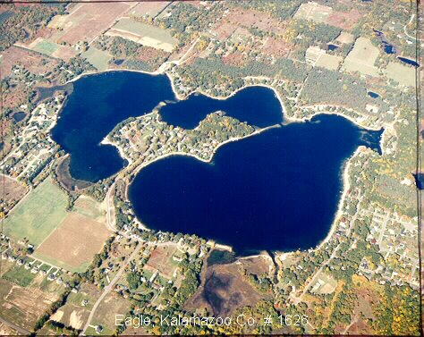

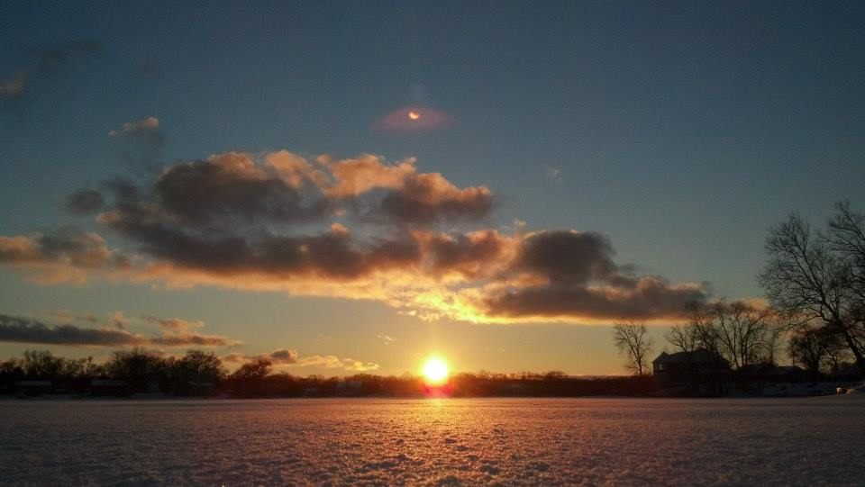
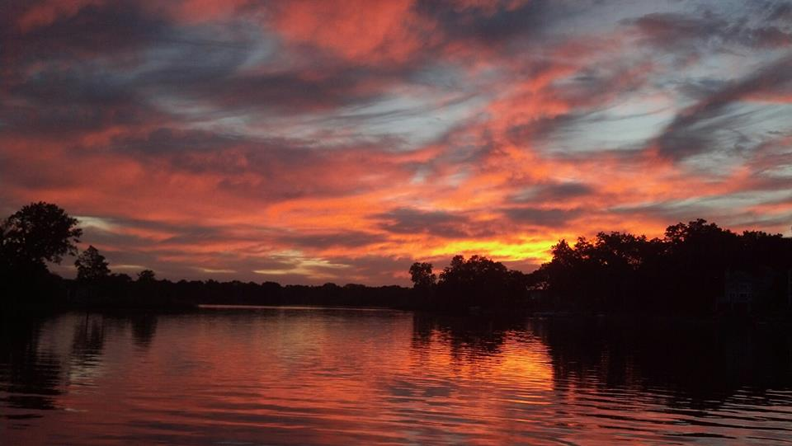

Slide 2
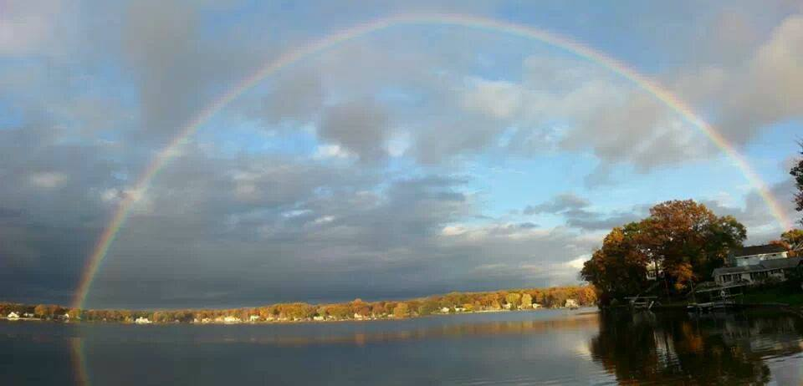
Eagle Lake Texas Association
Annual Meeting
May 16, 2018
7:00-8:30 Texas Township Hall

Slide 3
Meeting Agenda
Opening Welcome Ted Ryder
Minutes from last Annual Meeting Brett Cummings
Treasurer’s Report Jim Caporale
Nominations for Directors Self Nomination
Election of Directors Judge of Elections
Lake Management Report Dr. Jennifer Jermalowicz-Jones “Eagle Lake LFA Update”
New Business - Election Results Ted Ryder
“Lake Level Report & Signage” Ted Ryder, Krista Burkeen
“Goose Abatement Program” Phil DeYoung
Announcements / Q & A Ted Ryder
“Neighborhood Captains” Stand and Recognize
Invitation to Serve on Committees Committee Chairs
Adjournment
  (Post-meeting discussions in the parking lot)

Slide 4
General Business
Approval 2017 Annual Meeting Minutes (Brett)
Treasurer’s Report (Jim)
  Also see the quarterly newsletters
Nomination of Directors
  4 Open Positions
    Three 3-year terms (normal rotation)
    One 2-year term (vacant position)

Slide 5


Candidates for the ELTA Board of Directors
Kasi Casterline Brett Cummings Neil Harris Ken Toy
Bio’s for each nominee was listed in the previous newsletter.
If anyone else wants to self-nominate, speak up now or you can volunteer in 2019

Slide 6
Lake Management Update
“Eagle Lake LFA Update”
(aeration project)
Jennifer Jermalowicz-Jones, PhD
Water Resources Director
Restorative Lake Sciences

Slide 7
High Lake Level … is no secret
High Water – Steps Taken
The Michigan DNR and Kalamazoo County Sheriff’s Office have been notified of the issues.
Leaders Marine and D&R Sports have been contacted to request when they limit testing.
Created signage for public launch to inform boaters
Created signage for lake members (grab some tonight)
Contacted other nearby lake associations (Parks & Rec)
Attended township board meeting, who in turn followed up with DNR regarding temporary no-wake and drop-ins
Property owners responsible to protect their property
Permission from township to post signs at launch and on shore
Pumping water to other properties is between property owners

Slide 8
Election Results, Old/New Business, and Q&A
Election Results
Old Business and New Business
Lake Management Report
High Lake Level
Goose Roundup
Announcements
  Check upcoming newsletters, Facebook, Website for updates
  Check upcoming newsletter for contact information for board members
  Board Meeting immediately following (elect officers)
Invitation to Serve on Committees
  Communication/Membership
  Safety
  Lake Quality

