Slide 1
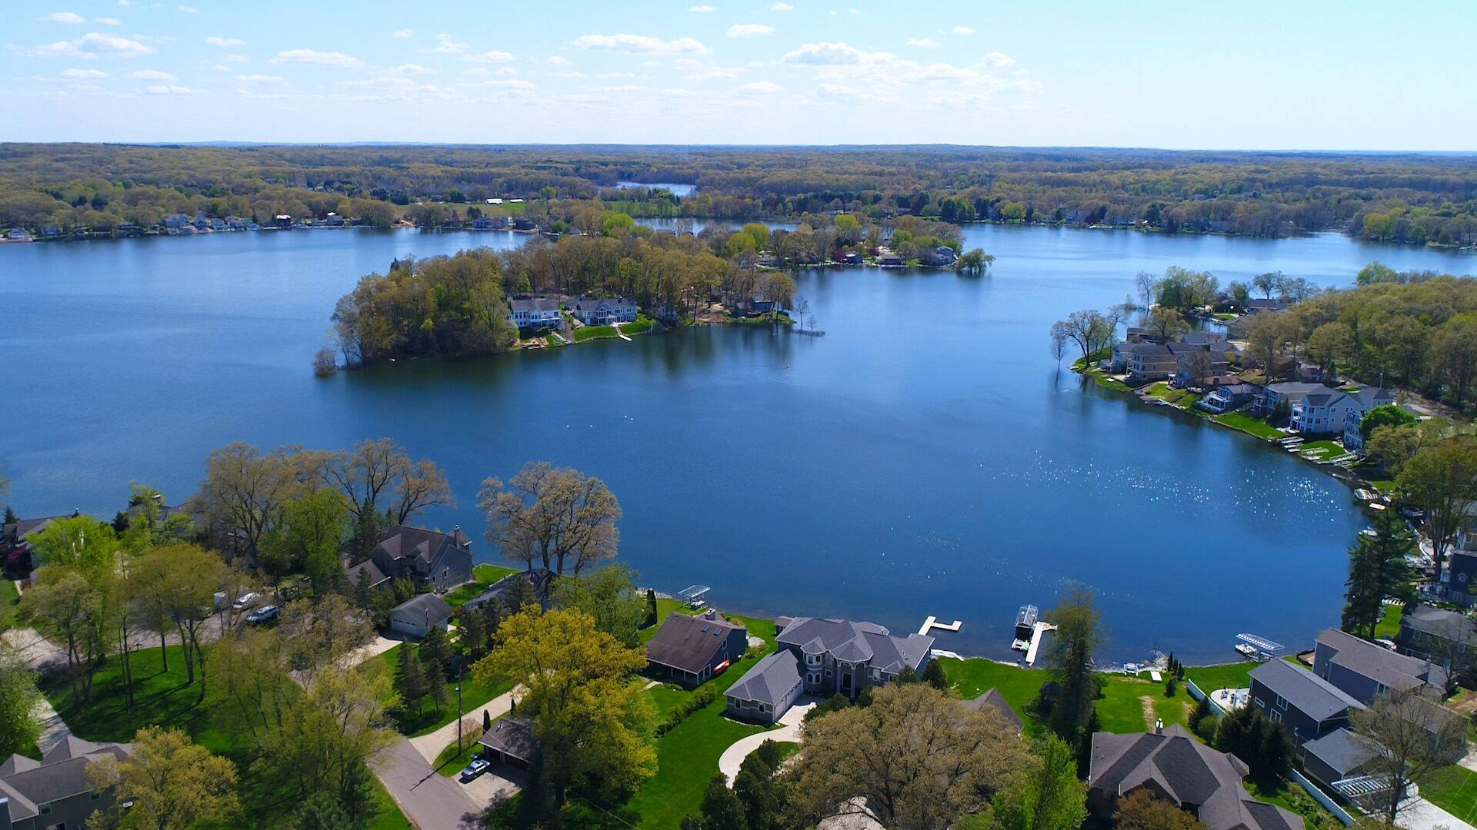
Eagle Lake Annual Meeting
May 17th, 2023

Slide 2
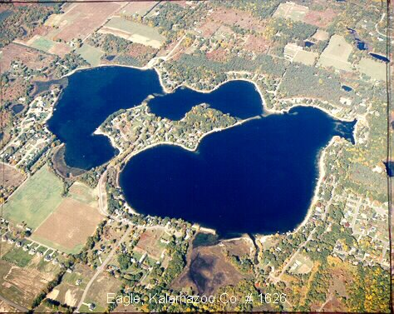
Agenda
Opening Welcome and President’s Report – Amy Coon
Board Nominations and Voting – Ken Toy
Approval of 2022 Annual Meeting Minutes – Ken Toy
Treasurer Report – Jim Caporale
Eagle Lake Annual Report – Grant Jones
Lake Quality – Ken Toy
Drain Project Update – Amy Coon
Communications / Social Committee – Kasi Barrow
Safety and Legal – Jason Machnik
AVB Property Presentation and Q&A – Jack Gesmundo
Questions / Comments
Closing – Amy
Notes:
Need to invite Eric Sauro to introduce himself, and invite Frank as well to say anything

Slide 3
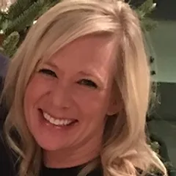
Welcome / President’s Report Amy Coon

Slide 4
Nominations and Voting
Current Nominations
Deb Duncan
Jack Gesmundo
Scott Ganton
Judy Lewis
Write-Ins welcome

Slide 5
Approval of 2022 Annual Meeting Minutes
Notes:
Brett

Slide 6
Drain Project Update
Short Term Pumping ended June 1, 2021
Lake Levels were still high and we needed a permanent fix
Eagle and Crooked Lakes petitioned the county to establish a Legal Lake Level
A circuit court judge issued the LLL on May 28, 2021.
Eagle Lake LLL was set at 899.26 and the special assessment district was created

Slide 7
Drain Project Update
Engineers submitted a permit application to EGLE
After many months of revisions, EGLE issued the permit Dec., 2022

Slide 8
Project Costs - Notes
First bidding 3-1-23 no bids received, second bidding 4-12-23 one bid received. Difficult bidding environment.
Initial construction bid of $4,914,248 reduced to $4,418,738
Cost sharing
Township (10%) - $530,000
County (12%) - $636,000
FEMA Grant - $1,679,475
Required Contingency - $724,326

Slide 9
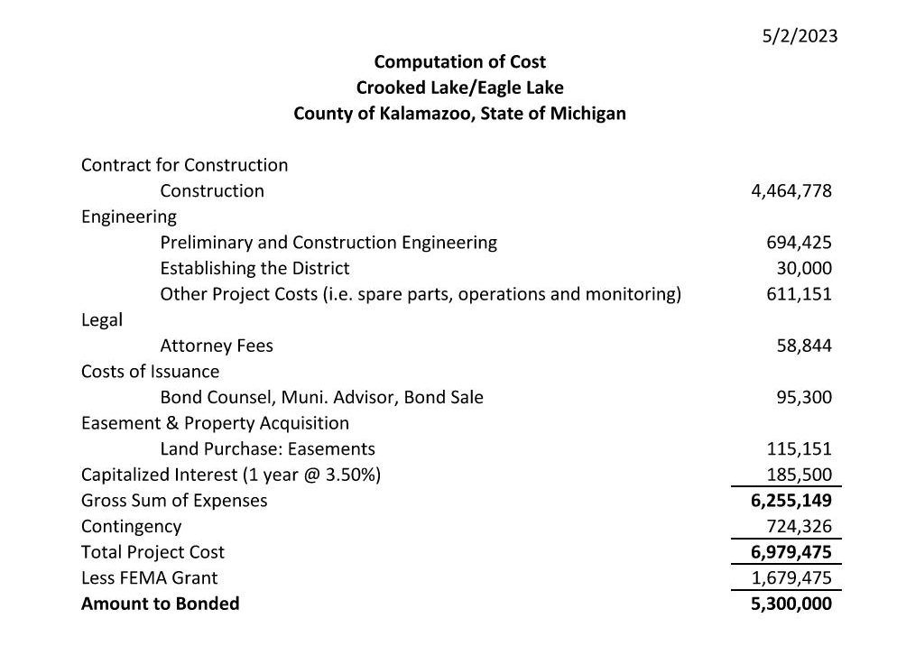
Project Costs

Slide 10
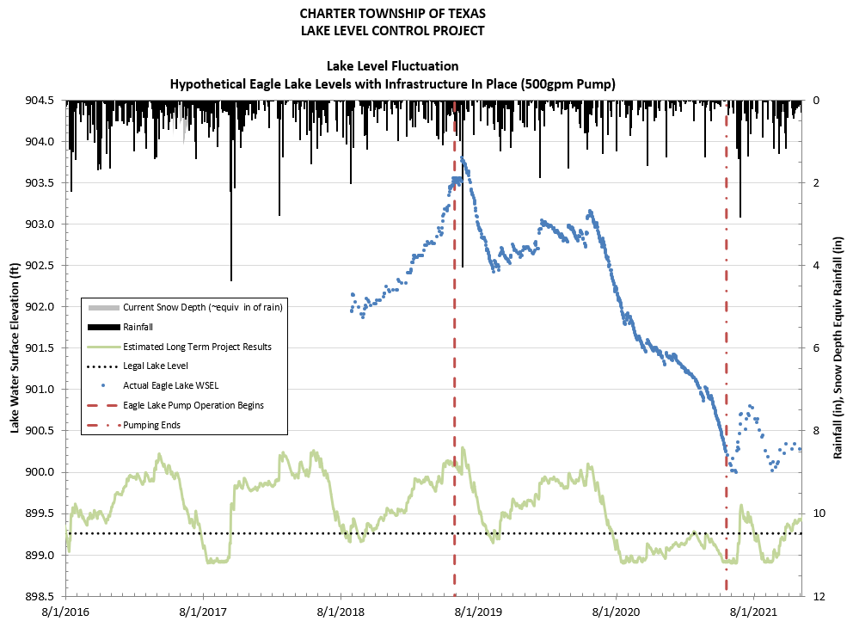

Slide 11
Drain Project Update
CONTACT INFORMATION:
Governor Whitmer:
https://somgovweb.state.mi.us/GovRelations/ContactGovernor.aspx
Phone Message 517-335-7858
Representative Christine Morse: ChristineMorse@house.mi.gov
Senator Sean McCann: smccann@senate.mi.gov

Slide 12
Prepayment Deadline & Construction Schedule
Residents may prepay their entire assessment to avoid interest costs. Please prepay by June 23rd.
The proposed schedule is to begin construction in September 2023, with a completion by July 1, 2024

Slide 13
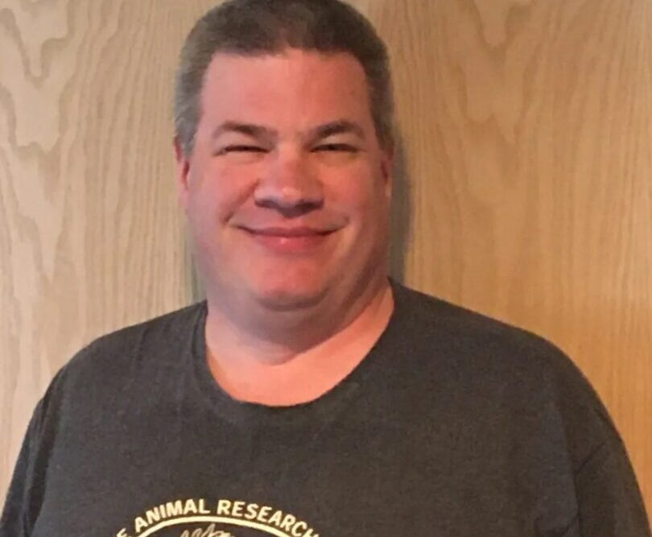
Eagle Lake Annual Report
Grant Jones Senior Lakes Field Manager Restorative Lake Sciences

Slide 14
Treasurer’s Report – Jim Caporale
Presenting the Following Summary Reports
Fiscal Year 2022
ELTA
SAD #1
SAD #2
Fiscal Year 2023 thru April 30
ELTA
SAD #1
SAD #2
Member Questions/Comments
Presenting the Following Summary Reports
Fiscal Year 2021
ELTA
SAD #1
SAD #2
ELTA Fiscal Year 2022 thru March 31
ELTA
SAD #1
SAD #2
Member Questions/Comments
To see line item detail refer to 1st & 2nd Quarter Newsletters

Slide 15
ELTA – Fiscal Year 2022
Revenues for the Period $ 9,352.91
Pass-Thru Revenues from TT for Aerator Power $ 3,184.61
Expenditures for the Period $ 9,230.33
Pass-Thru Expense to Compressor Hosts for Aerator Power $ 3,184.61
Net for the Period $ 122.58
Balance Brought Forward Start of the Period $ 12,897.14
Net Funds Available End of the Period $ 13,019.72

Slide 16
SAD #1 – Fiscal Year 2022
Revenues for the Period $ 287.58
Expenditures for the Period $ 56,065.81
Net for the Period $ (55,778.23)
Balance Brought Forward Start of the Period $ 75,214.61
Net Funds Available End of the Period $ 19,436.38

Slide 17
SAD #2 – Fiscal Year 2022
Revenues for the Period $ 1,129.20
Expenditures for the Period $ 9,374.81
Net for the Period $ (8,245.61)
Balance Brought Forward Start of the Period $ 95,668.01
Net Funds Available End of the Period $ 87,422.40

Slide 18
ELTA – Fiscal Year 2022 thru Mar 31
ELTA – Fiscal Year 2023 thru April 30
Revenues for the Period $ 7,732.92
Expenditures for the Period $ 1,679.92
Net for the Period $ 6,053.00
Balance Brought Forward Start of the Period $ 13,019.72
Net Funds Available End of the Period $ 19,072.72
To see line item detail refer to 2nd Quarter Newsletter

Slide 19
SAD #1 – Fiscal Year 2022 thru March 31
SAD #1 – Fiscal Year 2023 thru April 30
Revenues for the Period $ 88,503.76
Expenditures for the Period $ 2,086.43
Net for the Period $ 86,417.33
Balance Brought Forward Start of the Period $ 19,436.38
Net Funds Available End of the Period $ 105,853.71
To see line item detail refer to 2nd Quarter Newsletter

Slide 20
SAD #2 – Fiscal Year 2022 thru March 31
SAD #2 – Fiscal Year 2023 thru April 30
Revenues for the Period $ 337.14
Expenditures for the Period $ 3,480.00
Net for the Period $ (3,142.86)
Balance Brought Forward Start of the Period $ 87,422.40
Net Funds Available End of the Period $ 84,279.54
To see line item detail refer to 2nd Quarter Newsletter

Slide 21
Lake Quality Report
Aeration Restart – 14 of 16 operational
Bio-augmentation Treatment
Goose Roundup

Slide 22
Lake Quality Report - Aeration
Option 1 - Continue Aeration thru 2026
We would extend host license agreements thru 2026 to match timeline of current EGLE 5 year permit
We would use existing SAD2 funds to only pay for aeration electric and basic PLM aeration maintenance from 2023 thru 2026
We make a future aeration system decision sometime at beginning of 2026 whether to continue aeration system beyond 2026
Option 2 - Discontinue Aeration
We would remove all aeration equipment and lines mandated by EGLE at the end of 2023
We would auction off equipment that is Township owned at end of 2023 •
The remaining funds would be spent on bio augmentation treatments in 2024

Slide 27
Safety and Legal Update
Stay Safe
Use Common Sense
Always Watch for Boaters and Swimmers

Slide 28
Thank You! Len Bosma Phil DeYoung Jim Caporale

Slide 29
Thank You!

Slide 30
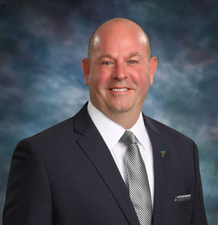
Long Term Project Update
Jason Wiersma
Kalamazoo County Drain Commissioner

